Slide 1
UNIT 9
Relays

Slide 2
Aim and Agenda of unit 9
Grasp the concept of a relay and get students acquainted with their usage
Aim of the presentation
Agenda of the presentation
Examine the basic relay types.
Examine their principle of operation.
Present the basic driving circuit of an electro-mechanical relay.
Present a basic electro-mechanical relay module, integrating the driving circuit.
Examine the key differences in the driving needs between electro- mechanical relays and solid-state relays.
Try some example exercises.
2

Slide 3
Introduction
Purpose of this unit is to grasp the concept of a relay; we will examine their basic types, their principle of operation, and we will take a brief introduction on their usage with microcontroller boards.
In essence, relays are electrically operated switches. They are used where it is necessary to control a circuit of any power by a separate lower-power signal, or where several circuits must be controlled by one signal.
3

Slide 4
Families of Relays
Relays come in many forms and variations (e.g. “mini” –or PCB- relays, automotive relays, industrial relays, etc.) but the major families, characterized by the type of switch used, are only two.
1. Electro-mechanical Relays
2. Solid-State Relays
4

Slide 5
Electro-mechanical Relays
They are based on Faraday’s law of electromagnetic induction.
First developed in 1833 (earliest type of relay).
An electromagnet operates the switch.
Since there is no contact between the coil and the switch, the load is electrically isolated from the control circuitry.
5

Slide 6
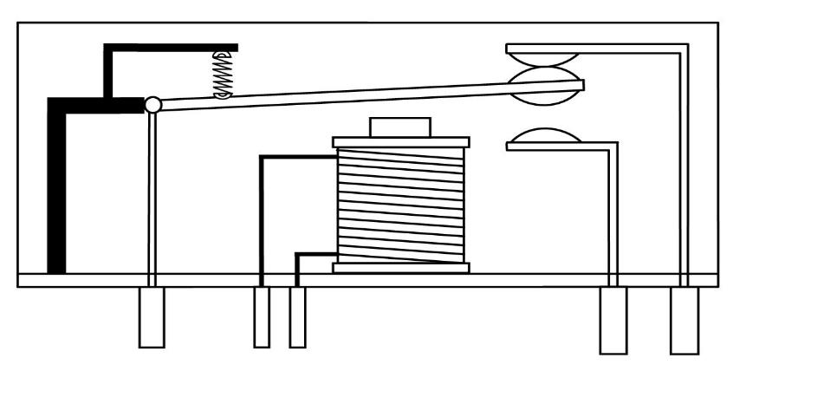
Electro-mechanical Relays
Components Of An
Electro-mechanical Relay
NC
COM
NO
COM
COIL
NO
NC
6

Slide 7
Relay Contacts & Terminals
COIL: Coil terminals. Typically, the coils of electro-mechanical relays have no polarity.
COM: Stands for “Common.” A contact that is either connected to NC, or NO, but not both at the same time.
NC: Stands for “Normally-Closed.” Connected to COM when there is no power applied to the coil.
NO: Stands for “Normally-Open”. Floating when there is no power applied to the coil. Connected to COM when there is adequate current flowing through the coil.
7

Slide 8
Interfacing Electro-mechanical Relays With MCUs
Electromechanical relays have specific voltage and power requirements for their switch to be triggered successfully. The most common relays have coils rated for 5/12/24 VDC or 115/230 VAC.
Microcontroller GPIO pins are not –typically- able to directly drive electro-mechanical relays. A special ‘driver’ circuit is required, which utilizes (most commonly) a bipolar, or MOSFET transistor alongside with a protection diode.
A number of ready-made modules exist for this purpose, easing the process.
8

Slide 9
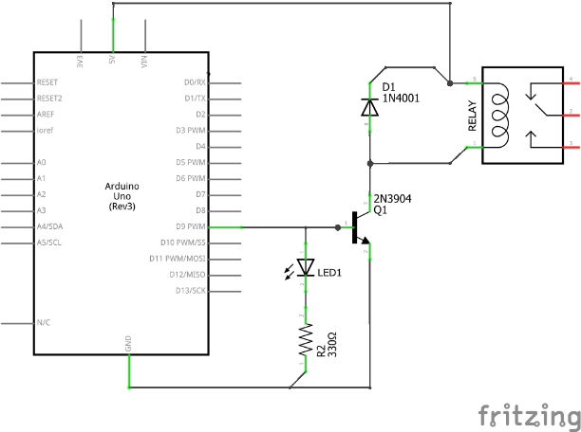
Interfacing Electro-mechanical Relays With MCUs
AC/DC LOAD
NC
COM
NO
AC/DC current
Relay Driver Circuit Schematic Diagram
9

Slide 10
A 5V Relay Module by Keyes
The module provides all the required components (the protection diode, the transistor switch and the current-limiting resistor) and an indicator LED into a handy package.
Normally-Open
GND
VCC
Common
SIG
Normally-Closed
10

Slide 11
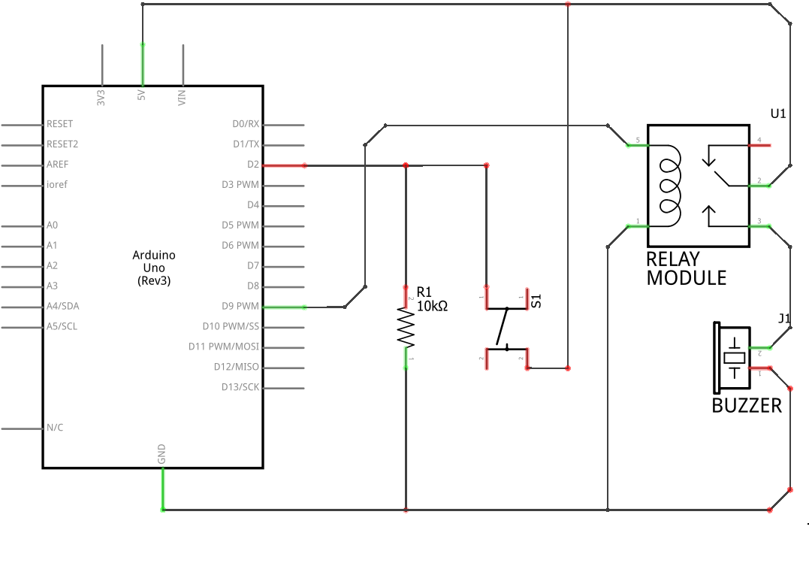
Electro-mechanical Relay Exercise: Description And Schematic
Purpose of this exercise is to make student acquainted with the use of an electro-mechanical relay. We are going to use an Arduino development board, together with a relay module to switch a DC load (a buzzer in our case).
Pressing a momentary push-button will change the state of the relay, arming or dis-arming its’ armature.
11

Slide 12
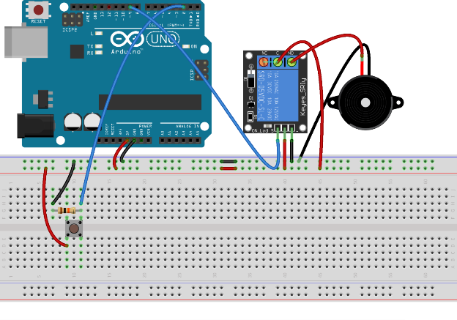
Electro-mechanical Relay Exercise: Breadboard
The circuit for the exercise, presented on a breadboard.
When the relay is armed (COM connected to NO) the buzzer should sound.
12

Slide 13
Electro-mechanical Relay Exercise: Description
Different configurations can be tried for familiarizing students with relays.
Some examples include:
The load can be connected to the NC output of the relay instead of the NO.
The relay can be used to switch the neutral wire instead of the load wire.
13

Slide 14
Electro-mechanical Relay Exercise: Code
// Allocate a byte named ‘state’ and initialize it with a value of LOW.
volatile byte state = LOW;
void setup() {
pinMode(2, INPUT); // Register GPIO pin 2 (switch) as an input.
pinMode(9, OUTPUT); // Register GPIO pin 9 (relay) as an output.
attachInterrupt(digitalPinToInterrupt(2), changeState, RISING);
// Configure an interrupt on GPIO pin 2 to trigger ‘changeState()’ on rising edge.
}
void loop() {
digitalWrite(9, state); // Drive GPIO pin 9 LOW or HIGH, depending on ‘state’.
}
void changeState() {
state = !state; // Change ‘state’ from LOW to HIGH or vice-versa.
}
14

Slide 15
Solid-state Relays
A TRIAC, SCR (silicon-controlled rectifier) or MOSFET switch, depending on the nature of the load (AC, or DC).
No moving parts resulting in increased reliability and lifespan.
Most often electrically isolated from the load (an opto-coupler controls the switch).
Typically, SSRs do have polarity, since they utilize semiconductor-based control elements (e.g. a light-emitting diode –LED-) instead of coils.
Since solid-state relays have no coil, no moving parts, and need lesser power than their electromechanical counterparts, they allow for easier interfacing with microcontrollers.
Most of the time no extra hardware is needed, and they can be operated directly from a microcontrollers’ GPIO. Sometimes, a current-limiting resistor is placed in series with the input of the relay.
15

Slide 16
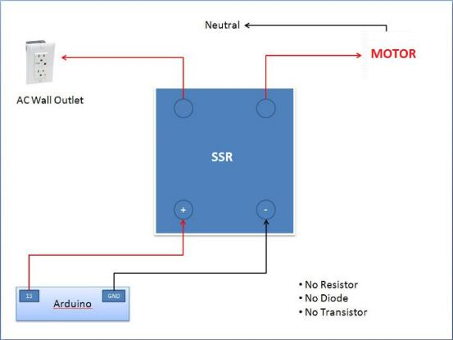
Interfacing Solid-state Relays With MCUs
16

Slide 17
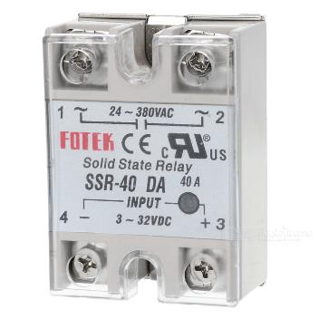
Solid-state Relay With Its Terminal Designations Visible
[~]: Load terminals. Load voltage can vary between 24-380 volts AC.
[–]: Control logic ground.
[+]: Control logic input (can be HIGH, or LOW). Logic HIGH can be up to 32 V, or as low as 3 V, allowing easy interfacing with various logic families.
17
17

Slide 18
Solid-state Relay Exercise: Description
In this exercise, we will change the electro-mechanical relay with a solid state one. The basic concept of the exercise remains the same (triggering a relay via a push-button).
Since most SSRs on the market are designed with AC loads in mind, we won’t be actually switching anything to avoid interacting with mains voltage.
18

Slide 19
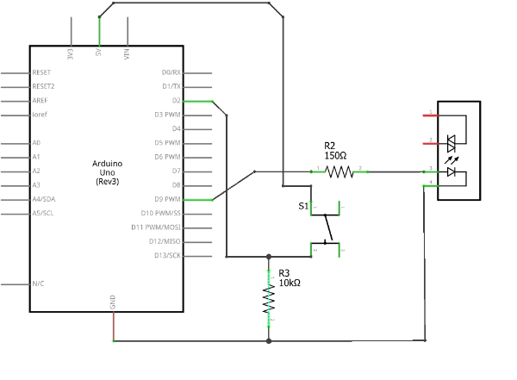
Solid-state Relay Exercise: Schematic
[150Ω]: Current-limiting
resistor.
[10ΚΩ]: Pull-down resistor.
Load Terminals
[
19

Slide 20
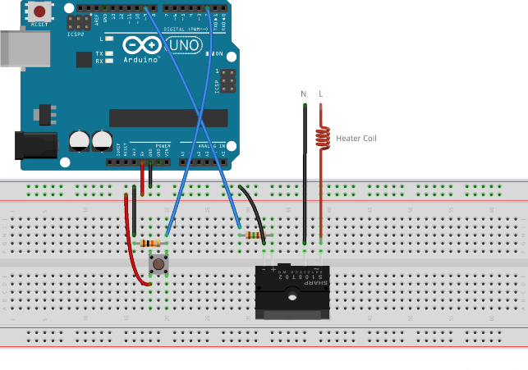
Solid-state Relay Exercise: Breadboard
The circuit for the exercise, presented on a breadboard.
The 150Ω resistor limits the current from the Arduino GPIO pin to avoid damaging the relay’s opto-coupler.
AC WALL OUTLET
20

Slide 21
Solid-state Relay Exercise: Code
Thanks to the driving circuits, triggering either an electro-mechanical relay, or a solid-state one, is achievable in the same manner. There are no code changes required, if, of course, the same GPIO pins are used.
21

Slide 22
UNIT 9 Relays
Thank You

