Slide 1
UNIT 8
OTHER SENSORS

Slide 2
Aim and Agenda of unit 8
Sensors measuring humidity and temperature
The aim of the presentation
The agenda of the presentation
Accelerometer
Types of accelerometers
NTC temperature sensors
Humidity sensors
DHT11 sensor
2

Slide 3
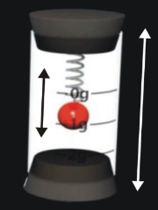
ACCELEROMETER
…..acceleration
….the rate of change in the speed of an object
....MEASURE:
…In m/s² or in terms of standard gravity (g)
(9,8 m/s2 or 1g)
A HOLLOW CYLINDER WITH A BALL INSIDE
The ball hangs from a spring and can move up or down inside the cylinder. If you move the cylinder up or down you create a force that displaces the ball. The distance of the displacement is proportional to the force applied which in turn is proportional to the acceleration of the cylinder when you moved it upwards.
3

Slide 4
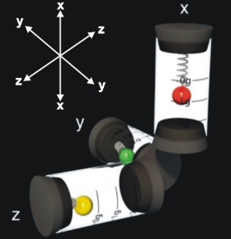
ACCELEROMETER
The ball inside each one of them will move according to the direction the cylinder is moved in: up or down, to the right or to the left, forwards or backwards. You can therefore measure the acceleration for each one of the axes X, Y and Z. This is known as a “three axis accelerometer”.
ACCELERATION is the rate of change in the speed of an object compared to the time this takes.
ACCELEROMETERS CAN THEREFORE DETECT MOVEMENTS, VIBRATIONS AND IMPACTS.
THREE IDENTICAL CYLINDERS
4

Slide 5
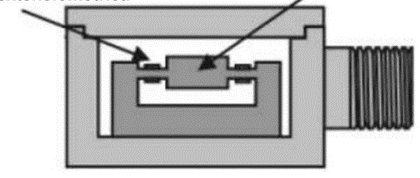
TYPES OF ACCELEROMETERS - mechanicals
These accelerometers use an inert mass and some elastic springs. The changes are measuring with strain gauges and include suspension systems that prevent excessive movement. The gauge creates a piezoresistive effect.
In other words, when the gauge warps its resistance changes; this causes the intensity that goes through it to change too and also the voltage.
Remember, I=V/R
When the sensor moves the mass moves too and “warps” the gauge; this causes variations in the resistance, intensity and voltage. These variations are directly proportionate to the acceleration of the movement applied to the sensor.
STRAIN GAUGE
MASS
5

Slide 6
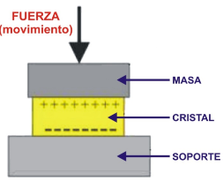
TYPES OF ACCELEROMETERS - piezoelectric
Piezoelectrical effect is the ability of certain materials to generate an electric charge in response to applied mechanical stress
Force (movement)
Mass
A movement from the sensor makes the inertial mass put pressure on the crystal which changes its structure. This generates an electrical charge proportionate to the pressure applied which in turn is proportionate to the acceleration or the strength of the movement.
Crystal
Support
6

Slide 7
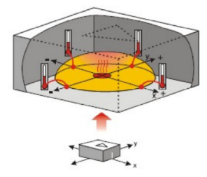
TYPES OF ACCELEROMETERS - thermal
detect and measure heat
When one of the sensor’s axes moves or turns, the hot gas bubble is displaced within the casing; this causes a rise in temperature in some of the thermal batteries and a fall in others. By comparing these temperatures, we obtain a proportional result to the acceleration of the movement.
A receptacle with a small heater that warms a gas bubble.
2 axes
4 temperature sensors
7

Slide 8
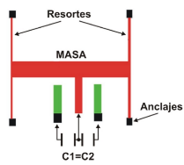
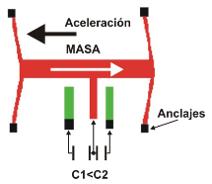
TYPES OF ACCELEROMETERS - capacitive
It consists of two metal plates separated by an insulating or dielectric material such as paper, ceramic or air. Its capacity depends on the size of these plates and/or the distance between them: the bigger they are and/or the closer they are, the greater their capacity is.
BASIC:
They modify the relative position of the plates in the condenser when it’s subjected to acceleration. The parallel movement of one of the condenser’s plates causes its capacity to vary.
Springs
Anchoring
Anchoring
8

Slide 9
TYPES OF ACCELEROMETERS - MEMS
MICRO ELECTRO MECHANICAL SYSTEMS
This technology is used to manufacture accelerometers, especially capacitive ones.
Nanotechnology
Micro machines
Nanomachines
Casing
<1 $cm^{2}$
Chip
2$mm^{2}$
Sensor
400 µ$m^{2}$
Plates
1 µm
9

Slide 10
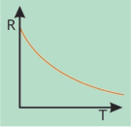
THE NTC TEMPERATURE SENSOR
NTC (or thermistor) is a negative temperature co-efficient resistor.
Easy to use
Economical
The resistance of NTC thermistors decreases as the temperature rises.
In other words, the hotter they get, the lower their level in ohms and vice versa.
10

Slide 11
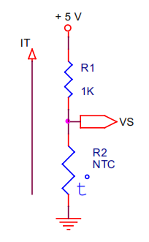
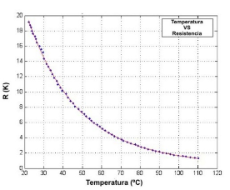
THE NTC TEMPERATURE SENSOR – basic circuit
The most basic one consists of a voltage divider with a fixed resistor connected in series with the NTC resistor; we apply a voltage of 5 V.
The Arduino ADC converter always uses the reference voltage, 5 V, so the resolution will be 0.00488 V (5 / 1023).
TEMPERATURE | 25º | 40º | 55º | 70º | 80º | 90º | 100º | 110º
R2-NTC (Ω) | 18KΩ | 10KΩ | 6KΩ | 4KΩ | 3KΩ | 2KΩ | 1K7Ω | 1K5Ω
OV | 4.73V | 4.54V | 4.28V | 4V | 3.75V | 3.33V | 3.14V | 3V
ADC OUTPUT | 969 | 930 | 877 | 819 | 768 | 682 | 643 | 614
11

Slide 12
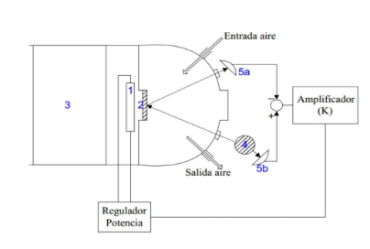
HUMIDITY SENSORS
These sensors rely on the changes in size that certain materials experience when exposed to humidity.
Mechanical
The air circulates through a chamber with a mirror inside (2). This air can be warmed or chilled using a cooling (3) or heating (1) system This way the vapour condenses on the mirror or the water evaporates from it.
Condensation
There’s also a light source (4) directed at the mirror. The mirror reflects the light onto a photo resistor (5a). This same light falls directly on a second photoresistor (5b).
Air inlet
So there are two measurements: the 5b phototransistor measures the real luminous intensity and another luminosity measurement which is distorted by the amount of condensation on the mirror (5a). The difference between the two intensities is multiplied and used on the power regulator that controls the heater and measures the humidity.
Amplifier
Air outlet
Voltage regulator
12

Slide 13
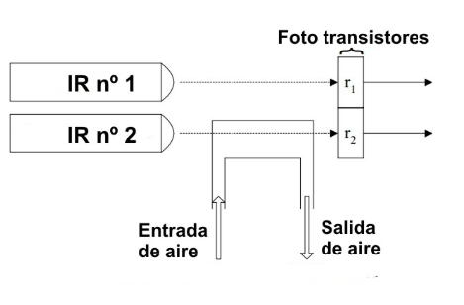
HUMIDITY SENSORS
Phototransistors
Infrared sensors
The difference between r1 and r2 makes it possible to calculate the degree of humidity in the air.
Air inlet
Air outlet
Resistive sensors
They consist of two conducting grids with parallel fingers separated from each other and mounted on a smooth, non conducting surface. The number of water molecules is proportionate to the degree of RH (relative humidity). Water is a conductor so the resistance between the two ends of the grid varies in proportion to the amount of humidity.
…………..Ohm’s law: if the resistance varies, the intensity and the voltage in circulation so do they.
13

Slide 14
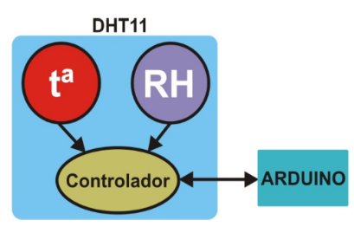
THE DHT11 SENSOR
www.aosong.com
This device integrates a temperature sensor based on an NTC resistor and a resistive humidity sensor.
You should also be aware that the device includes a controller. It reads the analogue intakes of both the NTC temperature sensor and relative humidity or RH resistive sensor. It oversees the calculations, adjustments, calibrations and processes necessary to provide your Arduino with accurate information whenever it receives a request.
CONTROLLER
!
14

Slide 15
THE DHT11 SENSOR - features
PARAMETER | HUMIDITY | TEMPERATURE
Resolution | 8 bits | 8 bits
Repeatability | ± 1% RH | ± 0.2ºC
Accuracy | ±5% to 25ºC | ± 1ºC
Range | 20% -90% from RH to 25ºC | 0ºC – 50 ºC
Supply voltage: 3.5 – 5 V
Consumption: 0.3 mA during measurement and 60 µA at rest.
Sampling period: more than 2 seconds
15

Slide 16
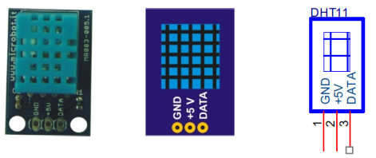
THE DHT11 SENSOR - introduction
The DHT11 comes installed on a small printed board or module that facilitates its connection.
www.microbot.it
Ref. N. MR003-005.1
1. GND:
2. +5V: voltage + 5V
3. DATA: Information outlet (relative humidity and temperature)
16

Slide 17
THE DHT11 SENSOR – 1-wire communication
1-wire
Arduino can communicate with a number of devices like this sensor and others using just one pin.
There’s a wide range of 1-wire devices on the market.
17

Slide 18
THE DHT11 SENSOR – 1-wire communication
How our DHT11 sensor communicates with the Arduino controller using a single cable or pin….
DATA | Byte 1 | Byte 2 | Byte 3 | Byte 4 | Byte 5
Binary | 0011 1100 | 0000 0000 | 0001 0010 | 0000 0000 | 0100 1110
Hexadecimal | 0x3C | 0x00 | 0x12 | 0x00 | 0x4E
Decimal | 60 %RH | 0 | 18 ºC | 0 | 78
When the host controller, Arduino, requests data from the sensor, the latter returns 40 bit (5 bytes) of data through the data pin. The first byte is an integer that represents the relative humidity as a percentage (%Rh) and the third is the temperature in degrees Celsius. Bytes 2 and 4 return 0x00. They’re used by other versions of the sensor with greater resolution to express the fractional part of the humidity and the temperature. Byte 5 represents the Checksum.
18

Slide 19
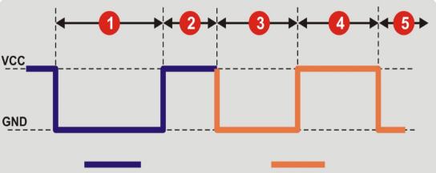
THE DHT11 SENSOR – 1-wire communication
It’s always the host controller, Arduino, that performs the initial sequence whenever it needs data from the sensor.
This is how our DHT11 does it:
Signal from the Arduino controller (host)
Signal from the sensor
After this exchange, the DHT11 starts to transmit the 40 bits of data from its internal humidity and temperature sensors.
19

Slide 20
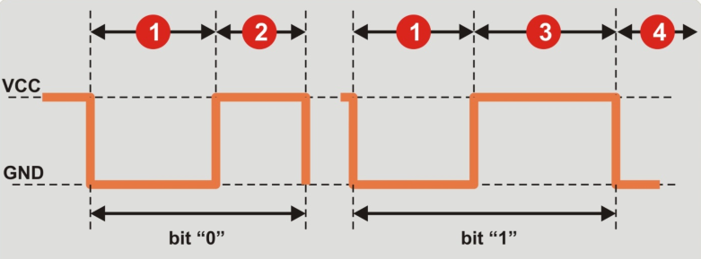
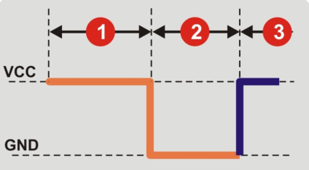
THE DHT11 SENSOR – 1-wire communication
Now Arduino collects and controls data…..
20

Slide 21
THE DHT11 SENSOR – the DHT11 library
http://www.microbot.it/sketches/DHT11.zip
The read() Function
Syntax:
read(pin);
pin: the data pin that’s connected to the DHT11 sensor; the data is received here.
Returns:
0: Correct device read
-1: Checksum error. The data received is not correct.
-2: Timeout. time overrun without response error.
-3: Busy. Error, the data line is engaged (possibly by another device).
humidity: 8 bit integer variable expressing the value of relative humidity as a percentage (%RH)
temperature: variable expressing the value of the temperature in degrees Celsius.
21

Slide 22
UNIT 8 OTHER SENSORS
Thank You

