Slide 1
UNIT 7: INFRARED SENSORS

Slide 2
Aim and Agenda of unit 7
INFRARED LIGHTS BASICS
Use IR sensor to detect objects, obstacles, the presence and movement of people and things, or send data.
The aim of the presentation
Electromagnetic spectrum
Infrared light
Generating and detecting
Infrared sensors
Encoding
The agenda of the presentation
2

Slide 3
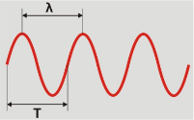
The electromagnetic spectrum
The electromagnetic spectrum is a collective term referring to the entire range and scope of frequencies of electromagnetic radiation and their respective, associated photon wavelengths.
F = Frequency or number of cycles per second
T = Period or time that a cycle lasts: This is the
inverse of the frequency T = 1 / F
3

Slide 4
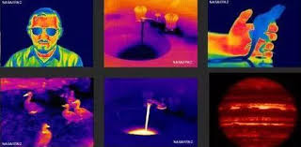
Infrared light
Infrared light is radiation released by any body with a temperature above 0º Kelvin (-273º C) or absolute zero. Its frequency is above microwaves but below visible light; that’s why we can’t see it. Its wavelength ranges from 0.7 µm (700 nm) to a 1000 µm which corresponds to frequencies from 4.28¹⁴ Hz to 3¹¹ Hz.
We all use IR radiation on a daily basis.
4

Slide 5
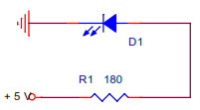
How to generate it and to detect it
Depending on the materials used to manufacture LED lights, they give off different colours.
An IR LED looks exactly the same as a conventional one and has very similar connections.
.
There are lots of LED lights that give off IR light and there are also lots of devices that detect it
5

Slide 6
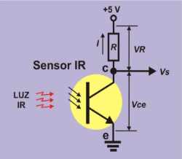
How to generate it and to detect it
PHOTORESISTOR
When it comes into contact with IR light, there’s a directly proportional flow of intensity (I) from the transmitter to the collector; this causes a fall in VR voltage in the R resistor.
1. If there’s IR light, the Vs goes to level “0”.
2. If there’s no IR light, the Vs goes to level “1”.
The total voltage (+5V) is shared between the resistor (VR) and the photoresistor (Vce). The more light there is the more I intensity. This in turn causes a rise in the VR and a consequent fall in the Vce. The Vs output voltage falls to “0”. If there is no IR light, the I intensity is non-existent, the VR disappears and the Vce rises to the maximum (+5V). The Vs output voltage goes to level “1”.
.
6

Slide 7
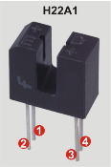
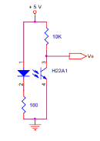
IR Sensors (transmissive and reflective)
An infrared sensor usually consists of a transmitter (T) and a detector (D).
TRANMISSIVE IR SENSORS
The transmitter is usually opposite the detector. When an object comes between the two the transmission of IR light is interrupted and a signal is generated.
The transmitter and the detector are contained in the same U-shaped capsule. On the left the diode transmitter corresponds to pins 1 (the anode) and 2 (the cathode). The phototransistor detector is on the right; pin 3 corresponds to the collector (c) and 4 to the transmitter (t).
.
Figure 6: H22A1
7

Slide 8
IR Sensors (transmissive and reflective)
Figure 6: H22A1
The IR emitting diode, between pins 1 and 2, is directly polarized with the 180 Ω absorption resistor. The phototransistor, between pins 3 and 4, receives the IR light. The Vs output voltage goes through the collector on pin 3. As long as it receives light it stays on level “0”. When we insert an opaque object in the slot and cut the beam of light, the output signal goes to level “1”.
.
8

Slide 9
IR Sensors (transmissive and reflective)
REFLECTIVE SENSORS
Light reflection is another way of detecting object.
In this case the transmitter and the reflector are positioned next to each other and not opposite. When the IR light that’s being transmitted strikes an object it’s reflected and “bounces” back towards the detector.
.
Like with transmissive sensors, there’s a huge variety of reflective sensors on the market and they can be adapted for use in any kind of situation.
9

Slide 10
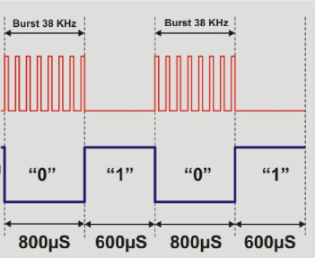
IR Sensors
OUT = the digital output when IR light adjusted to 38 Hz is detected
GND = the earth
VCC = positive voltage of +5V.
You can see what beams are like and the logic levels the sensor generates each time it detects one.
IR input light
.
Sensor output
10

Slide 11
IR Sensors
The IR emitting LED light goes on and off at a frequency of 38 KHz for a period of 800 μm for instance. This beam or “burst” illuminates the detector which generates a logic level of “0”. Then for another period of 600 μm the transmission is interrupted. The detector generates a logic level of “1” on the output.
IR input light
Sensor output
If the transmitter emits a burst of IR light and this is reflected off an object, the burst “bounces” back to the detector which generates a logic level of “0” at the output: object detected. If there’s no object there won’t be any reflection. The detector doesn’t receive the “burst” and no object is detected.
.
11

Slide 12
IR Sensors
On the other hand, imagine that the emitter is opposite the detector.
You already know that when a “burst” is emitted the detector generates a logic level of “0”; if there’s no “burst” it generates a logic level of “1”.
You’re transmitting bits and that’s data!
That’s the principle of IR remote control.
.
12

Slide 13
Encoding
A PRACTICAL APPLICATION OF TRANSMITTING BITS OF DATA BY IR LIGHT IS REMOTE CONTROL
When you press a button on the handset it sends out a stream of pulses of infrared light. Each button has a unique binary code. The infrared light pulses encoding it the receiver in the device recognizes the code, decodes it and converts it back to the original binary one.
.
13

Slide 14
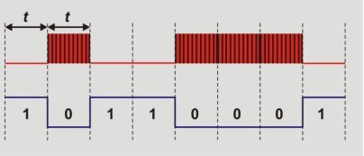
Encoding (“our” protocol)
How do we encode or modulate the IR light to transmit or receive bynary codes?
Beams emitted
Detector output
……for example if you want to transmit the 8 bit binary code 10110001, all you have to do is generate or not generate a series of beams with the LED light emitter for the unit of time t.
At fixed intervals (+) of 1 mS for instance, the 38 Hz beams of IR light are emitted or not. During this same 1 mS period of time read the detector pin: it’ll be on “0” if the beam is being received or “1” if it’s not.
14

Slide 15
Encoding (“our” protocol)
How do we distinguish one code from the next? This is important to remember when a code ends with the same bit as the next one begins with. Suppose a code ends with the bit “1” and the next code begins with “1” too.
Say two bits are received one after the other and they’ve both got the same value of “1” or “0”. You read the detector output in the time periods t but if these get slightly out of synch, how do you distinguish between the previous bit and the next one?
….’our’ protocol….
15

Slide 16
Encoding (“our” protocol)
Now you can see that transmitting a “0” bit or a “1” bit isn’t just a matter of sending out a beam of light.
The beam has to last for a certain period of time (600 μm or 1,200 μm) and, in addition to this, it has to be followed by a “blank” space of 600 μm for instance.
All the codes transmitted or received contain 8 bits which is equal to 1 byte.
We start off by transmitting or receiving the least significant bit (LSB), the one on the extreme right in the byte.
All the codes begin with an initial state that comprises a beam that lasts for 2,400 μm followed by a space of 600 μm. This bit, known as “start”, enables us to see where the new byte or code begins.
16

Slide 17
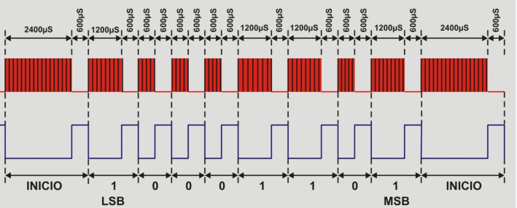
Encoding (“our” protocol)
You will notice that that the basic idea is to control the time the detector output level stays on “0” for each bit. If it stays on “0” for 2400 μS we’re dealing with the start bit which introduces a new byte or code. If, on the other hand, it stays on “0” for 1200 μS we’re dealing with a “1” bit and if it stays on “0” for 600 μS we’re dealing with a “0” bit. Between one bit and the next the detector output has to stay on level “1” for 600 μS.
17

Slide 18
Encoding (the “ourlr” library)
OurIr.h: this file contains the names of all the functions in the library.
OurIr.cpp: this file contains the code or instructions for executing the functions.
It’s only got three functions.
The burst() function generates a 38 KHz burst on the pin indicated and for the desired time.
Syntax
Burst(pin,time);
pin: the output pin for the 38 KHz burst
time: duration of the burst in microseconds
The IrTx() Function sends out a piece of data on the pin indicated in accordance with “Our” protocol.
Syntax:
var.IrTx(pin, data);
pin: output pin
data: 8 bit data to be transmitted
The IrRx() Function returns the 8 bit data received on the indicated pin in accordance with the “Our” protocol.
Syntax
var.IrRx(pin);
pin: Input pin
18

Slide 19
Encoding (other protocols)
http://www.sbprojects.com/knowledge/ir/index.php
http://www.righto.com/2009/08/multi-protocol-infrared-remote-library.html
19

Slide 20
UNIT 7 INFRARED SENSORS
Thank You

