Slide 1
UNIT 5
Analog signals

Slide 2
Aim and Agenda of unit 5
Give the basic ideas about analog signals and use different kinds of peripherals
The aim of the presentation
The agenda of the presentation
Explain basic ideas about digital conversions and resolution
Present different functions to use analog signals with Arduino
Present some analog peripherals
Present knowledge about PWM signals
2

Slide 3
ANALOG SIGNALS
You’re already aware that everything in the “digital” world works on the assumption that there are only two possible values or levels: level “1”and level “0”.
Nevertheless, the “real” world isn’t like that. We come across physical quantities in the natural world that may have multiple values or other features and we need ANALOG SIGNALS
NOT EVERYTHING IS BLACK OR WHITE; THERE ARE GREYS AS WELL!!
3

Slide 4
DIGITAL CONVERSION
There are all types of sensors and “transducers” that are able to measure and deliver analog voltage equivalent to the physical quantity they’re measuring
We have to convert the analog voltages into their equivalent digital or binary values
To perform this conversion we use “analog-to-digital converters”, abbreviated to “ADC”.
Arduino have an integrated ADC converter circuit
All you have to do is connect up the appropriate sensor or transducer to the analog input pin
ADC converter
(100100101)
Digital Processing
(+,-,&,*,|)
Temperature
Arduino UNO’s conversion speed is more than enough to measure most analogical physical quantities!
4

Slide 5
RESOLUTION
Another important factor in an ADC converter circuit is its precision or “resolution”.
How do we establish a relationship between the analog voltage and the binary value?
We need to know a constant called the “reference voltage” or VREF which is the voltage the converter circuit uses to perform its internal operations
Arduino UNO has a resolution of 10 bits. This means that the result of a conversion may have 1024 possible binary values (2^10)
THE FOLLOWING IS VERY IMPORTANT! The analog input voltage that you measure must NEVER exceed the VREF reference voltage
5

Slide 6
FUNCTIONS IN ARDUINO LANGUAGE
ANALOGREFERENCE() FUNCTION
This function makes it possible to set the value of the reference voltage (VREF) the ADC converter circuit has to use to convert an analog voltage into its binary or decimal equivalent
The VREF voltage must not exceed the voltage that powers the Arduino UNO controller (5 V)
analogReference(type);
type: Configures the VREF used for analog input. The options are:
DEFAULT: the default analog reference of 5 volts (on 5V Arduino boards) or 3.3 volts (on 3.3V Arduino boards).
INTERNAL: This is a VREF generated within the controller. In the case of Arduino UNO it’s 1.1 V
EXTERNAL: The required VREF is delivered on the controller’s AREF pin.
6

Slide 7
FUNCTIONS IN ARDUINO LANGUAGE
ANALOGREAD() FUNCTION
This is the sentence you’re going to use when you want to perform an analogical to digital conversion
Each time it’s executed it takes a sample of the voltage on the analog pin
analogRead(pin);
pin: The pin number that corresponds to the analog channel you want to convert. In the case of Arduino UNO this could be from A0 to A5.
7

Slide 8
FUNCTIONS IN ARDUINO LANGUAGE
MAP() FUNCTION
Arduino ADC converter has a resolution of 10 bits and can express a value between 0 and 1023 (2^10)
Arduino works with come in packets of bytes (8 bits) or multiples of bytes
This function makes it possible to remap, reassign or redefine a value between a minimum and a maximum.
map(value, fromLow, fromHigh, toLow, toHigh);
value: the number to map. It’s usually an int (16 bits) or a long (32 bits). fromLow: Expresses the lower bound of the value's current range.
fromHigh: Expresses the upper bound of the value's current range.
toLow: Expresses the lower bound of the value's target range.
toHigh: Expresses the upper bound of the value's target range.
8

Slide 9
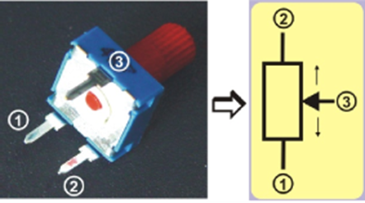
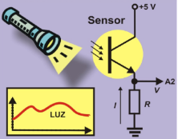
ANALOG PERIPHERALS
POTENTIOMETERS
Variable resistors and you can modify their value by moving the shaft or a control called the “wiper”
They’re the simplest and most economical analog peripherals you’ll find
PHOTO SENSORS
This is based on a small device called a “phototransistor”
This component increases or decreases the amount of current that passes through it based on the amount of light that strikes it
9

Slide 10
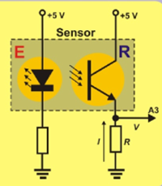
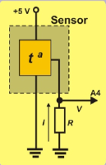
ANALOG PERIPHERALS
IR REFLECTIVE SENSORS
It detects infrared light (IR) not visible to the human eye
The sensor comprises two components. The LED light or emitter (E) and the photodiode or receiver (R)
TEMPERATURE SENSOR
This component has three pins
Two of them are connected to the supply voltage of 0 and +5 V
The intensity, I, which circulates through the third pin, is directly proportional to the temperature
10

Slide 11
PSEUDO ANALOG OUTPUT
Arduino UNO controller board has 14 pins that can be configured as digital inputs or outputs
six of these pins can function as PWM signal output pins, 3, 5, 6, 9, 10 and 11, the ones preceded by the “~” sign
WHAT ARE PWM SIGNALS??
PWM” stands for “Pulse Width Modulation”, an “asymmetric” periodic digital signal of “1”s and “0”s which is repeated constantly at the same frequency
The time the signal is on level “1” is called a “duty cycle”
11

Slide 12
PSEUDO ANALOG OUTPUT
Arduino UNO controller board has 14 pins that can be configured as digital inputs or outputs
six of these pins can function as PWM signal output pins, 3, 5, 6, 9, 10 and 11, the ones preceded by the “~” sign
WHAT ARE PWM SIGNALS??
PWM” stands for “Pulse Width Modulation”, an “asymmetric” periodic digital signal of “1”s and “0”s which is repeated constantly at the same frequency
The time the signal is on level “1” is called a “duty cycle”
PIN Nº | FREQUENCY, F | PERIOD, T
5 and 6 | 980 Hz | 1.02 mS or 1020 µS
3, 9, 10 and 11 | 490 Hz | 2.04 mS or 2040 µS
12

Slide 13
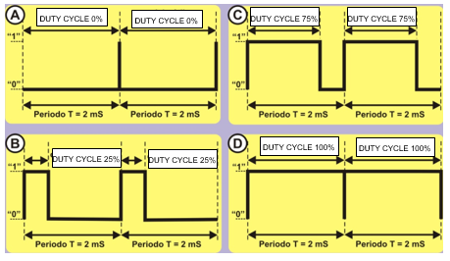
PSEUDO ANALOG OUTPUT
13

Slide 14
PSEUDO ANALOG OUTPUT
WHAT ARE THEY USED FOR??
We can control the time we remain on level “1” for each period with PWM signals
You don’t have to configure the pin that generates the PWM signal as an output
The time the signal is on level “1” is called a “duty cycle”
HOW ARE THEY GENERATED?
THE ANALOGWRITE() FUNCTION
This function makes it possible to adjust the length of the duty cycle of a PWM output signal.
analogWrite(pin, value);
pin: the pin to write to. This refers to the pin that’s going to generate the PWM signal. value: determines the length of the duty cycle. It’s a byte number between 0 and 255.
14

Slide 15
UNIT 5 Analog Signals
Thank You

