Slide 1
UNIT 1
First programs

Slide 2
Aim and Agenda of unit 1
Create some initial programs that enable you to work quickly and easily with digital input and output (I/O). We will have a look at the basic statements you need to use digital input and output;
The aim of the presentation
The agenda of the presentation
Explain what a program looks like
Present program staments
Logic operators
2

Slide 3
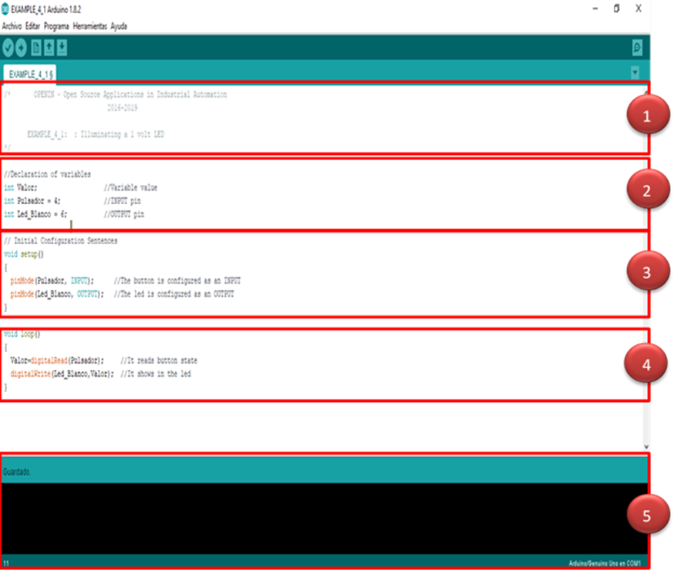
WHAT A PROGRAM LOOKS LIKE
3

Slide 4
WHAT A PROGRAM LOOKS LIKE
COMMENTARY SECTION
All programs should begin by supplying certain information
This information is called the “Header Comments”
You can include all the comments you want wherever you want as long as they appear between the symbols “/*” and “*/”
1
4

Slide 5
WHAT A PROGRAM LOOKS LIKE
VARIABLE AND FUNCTION DECLARATION
Use this second section to declare variables and functions
Think of a variable as a kind of box or receptacle you assign a name and possibly a value to
Generally speaking, both the variables and the functions must be declared BEFORE being used in the program.
5

Slide 6
WHAT A PROGRAM LOOKS LIKE
CONFIGURATION TASK
Programs written in Arduino language begin by executing a few configuration instructions or functions.
Generally speaking, the configuration statements or functions are only executed once when you RESET the system or connect it to a power source.
6

Slide 7
WHAT A PROGRAM LOOKS LIKE
MAIN BODY OF THE PROGRAM
You have to write all the instructions, statements and functions that make up your program in this section
The controller executes all the functions that make up the main body of the program as fast as possible. It executes them constantly and indefinitely from first to last.
Important: When declaring the variables and configuration and main program functions, make sure they ALWYS end with this symbol: “;”.
4
7

Slide 8
WHAT A PROGRAM LOOKS LIKE
MESSAGES SECTION
It will tell you whether you’re saving, compiling or recording a program on the controller’s memory
It’ll also let you know if there have been compilation errors, the type of error and where they have occurred.
“Compile” a program means to translate the one you’ve written using complex Arduino language into binary code (also known as machine language); this is what is actually recorded on the controller’s FLASH memory
8

Slide 9
PROGRAM STATEMENTS
The setup() Function
This function and all the other functions contained in it are ONLY executed when the system is reset
There are usually a number of other functions within this one: input and output pin configuration, certain variable settings, libraries etc.
You can put whatever statements and functions you like in the setup() function as long as they are enclosed by curly braces: “{...}”
Syntax:
Void setup()
{
.......
}
9

Slide 10
PROGRAM STATEMENTS
The PINMODE() Function
Configure one of the Arduino controller’s pins as an input or an output
It usually comes at the beginning of a program and is included in the setup() function
All the digital pins are automatically configured as inputs when you reset the system.
Syntax:
pinMode(pin,mode);
pin: This is the number of the pin we’re going to configure; it may be between 0 and 13 in Arduino Mode: This establishes whether it functions as an INPUT or OUTPUT
10

Slide 11
PROGRAM STATEMENTS
The digitalread() Function
This function reads and returns the binary logic state (“1” or “0”, “HIGH” or “LOW”) of any of the Arduino controller pins
Syntax:
digitalRead(pin);
pin: This displays the number of the pin we’re going to read; it may be between 0 and 13 in Arduino
11

Slide 12
PROGRAM STATEMENTS
The digitalwrite() Function
Writes or sets a binary value (“1” or “0”, “HIGH” or “LOW”) through an output pin
Syntax:
digitalWrite(pin, value);
pin: This displays the number of the pin we’re going to read; it may be between 0 and 13 in Arduino
Value: Indicates the value to be set (“1” or “0”, “HIGH” or “LOW”).
12

Slide 13
Logical operators
The not operator
This operator expresses a negation (NOT) and is represented by an exclamation mark (!)
Example:
Value = ! digitalRead(12);
Value equals level 1 if → pin12 is at level 0
Value equals level 0 if → pin12 is at level 1
13

Slide 14
Logical operators
The AND operator
This operation generates a level “1”, also known as “true”, when ALL the elements that you relate to each other are also at level “1”
It’s represented by these symbols: “&&”
Example:
Value =digitalRead(4) && digitalRead(8) && digitalRead(12);
Value equals level 1 if → pins 4,8 and 12 are at level 1
Value equals level 0 if → pins 4,8 or 12 are at level 0
14

Slide 15
Logical operators
The or operator
This operation generates a level “1”, also known as “true”, when ANY of the elements that you relate to each other are also at level “1”
It’s represented by these symbols: “||”
Example:
Value =digitalRead(4) || digitalRead(8) || digitalRead(12);
Value equals level 1 if → pins 4,8 or 12 are at level 1
Value equals level 0 if → pins 4,8 and 12 are at level 0
15

Slide 16
Logical operators
COMBINING operatorS
You can of course combine various logic operators in the same function
You have to use parentheses to establish the order they have to be assessed and calculated
Example:
Value = (digitalRead(8) && ! digitalRead(12)) || digitalRead(4));
Value equals level 1 if → pin 8 is at level 1 and pin 12 is at level 0 or pin 4 is at level 1
Value equals level 0 if → pin 8 is at level 0 or pin 12 is at level 1 and pin 4 is at level 0
16

Slide 17
UNIT 1: First programs
Thank You

