Slide 1
UNIT 14
Communication Protocols

Slide 2
Aim of Unit 14
Familiarization of students with the most popular communication protocols for Internet of Things’ application development, namely: Bluetooth, Ethernet and WiFi.
Aim of the presentation
Agenda of the presentation
Interfacing Arduino with a Mobile Application via Bluetooth
Interfacing Arduino with a Web Application via Ethernet
Interfacing Arduino with a Web Application via WiFi
Try some example exercises.
2

Slide 3
Introduction
Aim of this UNIT is to familiarize students with most popular communication protocols for developing Internet of Things applications, namely Bluetooth, Ethernet and WiFi.
We will practice these protocols through a simple bidirectional communication scenario that involves an Arduino development board and a mobile (for Bluetooth) or web application (for Ethernet and WiFi) exchanging sensor data and remotely controlling the status of a LED.
Taking into account the scope of OpenIn, the emphasis of the Unit will be given on the Arduino programming. Hence, we will be demonstrating the mobile and web applications without focusing on their development.
3

Slide 4
BLUETOOTH

Slide 5
Bluetooth
Bluetooth is a popular and convenient communication protocol, with most smartphones and tablets integrating such an interface.
Bluetooth is also a very convenient protocol for Arduino-based applications, since the commercially available modules are affordable and easy to interface with and program, using serial communication protocols (such as UART).
In this scenario, we are going to user the widely available HC-05 Bluetooth module alongside with the Serial Bluetooth Terminal application for the Android operating system available on the Google Play store for data exchanging between the Arduino and a mobile phone, or tablet.
5

Slide 6
Bluetooth Exercise: Description
We will practice these protocols through a simple bidirectional communication scenario that involves an Arduino development board and a mobile (for Bluetooth) or web application (for Ethernet and WiFi) exchanging sensor data, and remotely controlling the status of a LED.
Taking into account the scope of OpenIn, we will be demonstrating the mobile and web applications without focusing on their development.
6

Slide 7
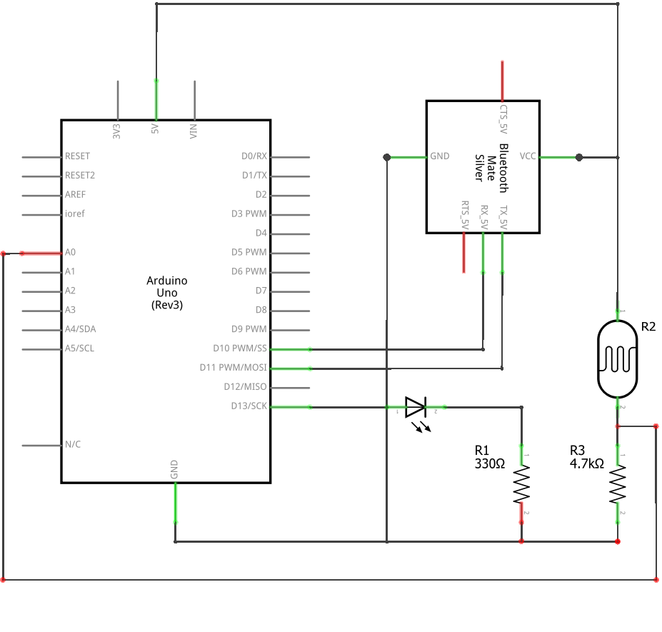
Bluetooth Exercise: Schematic
The HC-05 is a Bluetooth Classic module available from various distributors. The LDR (R2) alongside with R3 form a voltage divider from which we will be taking analog voltage readings.
7

Slide 8
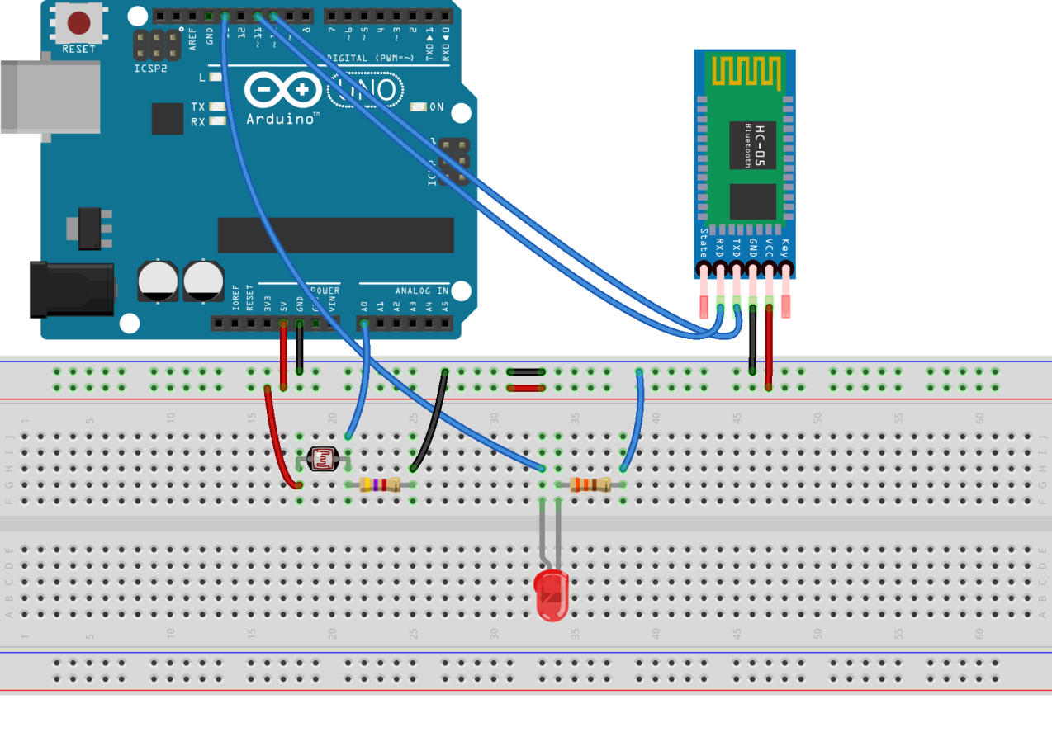
Bluetooth Exercise: Breadboard
The same circuit presented on a breadboard for easier prototyping.
8

Slide 9
Bluetooth Exercise: Code (1)
#include <SoftwareSerial.h>
// Initialize a software UART on GPIO 10, 11.
// Since the hardware UART (GPIO pins 0, 1) will be used by USB for programming and debugging,
// we’ll be needing another UART port.
SoftwareSerial bluetooth(10, 11); // 10 = RX, 11 = TX
byte bt_input ;
double ldr_input;
unsigned long prev_time = 0;
unsigned long curr_time = 0;
void setup()
{ pinMode(13, OUTPUT); // Register GPIO 13 (the LED) as an output.
// Initialize Bluetooth communication with a baud-rate of 9600 bps on the software UART port.
bluetooth.begin(9600);
// Initialize serial communication (hardware UART) with a baud-rate of 9600 bps.
Serial.begin(9600);
// Trigger a small delay for everything to settle.
delay(500);
}
9

Slide 10
Bluetooth Exercise: Code (2)
void loop()
{
// Check for incoming data.
if (bluetooth.available())
{
// Read incoming data.
bt_input = bluetooth.read();
// If the incoming character is a ‘1’, set GPIO 13 (LED) ‘HIGH’.
if ((char)bt_input == '1')
{
digitalWrite(13, HIGH);
}
// If the incoming character is a ‘0’, set GPIO 13 (LED) ‘LOW’.
if ((char)bt_input == '0')
{
digitalWrite(13, LOW);
}
// Print the character read to the hardware UART for debugging purposes.
Serial.println(bt_input);
}
10

Slide 11
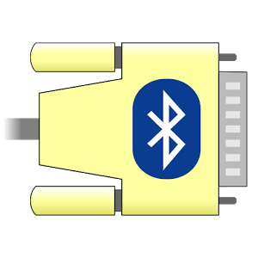
Bluetooth Exercise: The Mobile Application
Various mobile applications exist for communicating
over a Bluetooth connection. They are available for
most platforms, including Android and iOS.
Since we will be exchanging serial data, and we
need a little more control over the process, we picked Serial Bluetooth Terminal for the Android operating system by Kai Morich (available on the Google Play Store). As the name implies, it is a terminal application for serial devices.
11

Slide 12
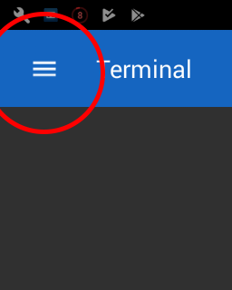
Bluetooth Exercise: The Mobile Application
The application will show an empty terminal screen upon launching. We will need to connect to a Bluetooth device before being able to exchange serial data.
Tap on the icon next to the ‘Terminal’ label to open the application menu.
12

Slide 13
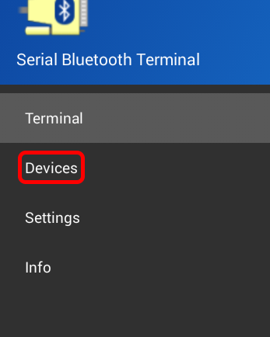
Bluetooth Exercise: The Mobile Application
As soon as the menu shows up, tap on ‘Devices’.
13

Slide 14
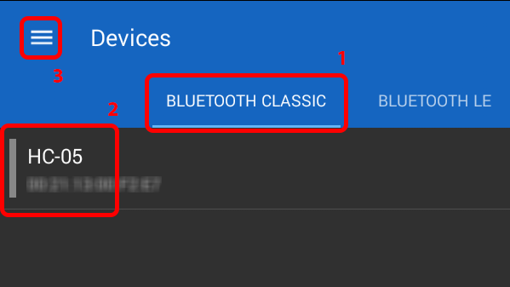
Bluetooth Exercise: The Mobile Application
(1) Select between Bluetooth Classic or BLE (depending on the module that you have used) and then (2) tap on its name. Finally, (3) tap again on the menu icon and select ‘Terminal’ to get back to the main screen.
14

Slide 15
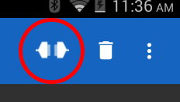
Bluetooth Exercise: The Mobile Application
The last step is to tap on the ‘Connect’ icon.
This will establish the connection between your
device and the Bluetooth module that you
selected.
That’s it! Now the application is ready to exchange data with the Bluetooth module.
15

Slide 16
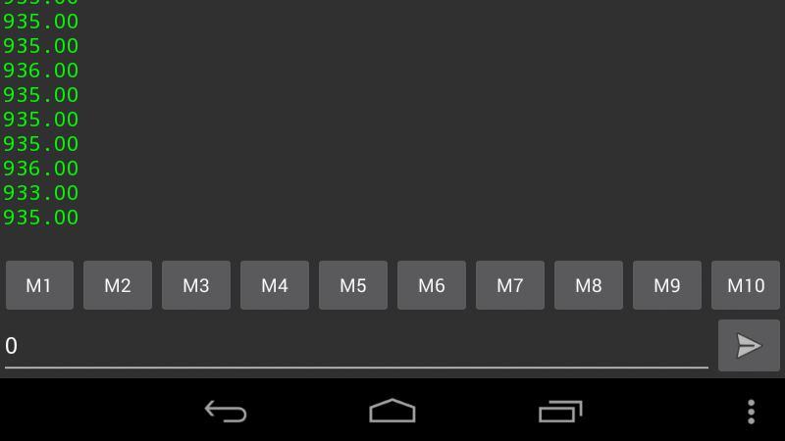
Bluetooth Exercise: Conclusion
If you have compiled and
uploaded the provided code
on your Arduino board,
you should now be able to
see the incoming data on
the application’s terminal.
Apart from that, you
should be able to change the status of the connected LED by simply sending a single-character string of ‘1’ or ‘0’.
SEND BUTTON
16

Slide 17
ETHERNET

Slide 18
ETHERNET - Introduction
Ethernet is another popular and convenient communication protocol since it enables wired communication with the world of internet. By using Ethernet, an Arduino application can communicate with any TCP/IP–based application including rich web applications.
The available Ethernet Shield is an affordable, reliable and easily-programmable way to enrich an Arduino-based application with Ethernet capabilities.
We are going to use the Ethernet Shield in order to achieve bidirectional communication with the custom web application we have developed for this purpose.
18

Slide 19
ETHERNET Exercise: Description
In this exercise we will combine an Arduino development board with an Arduino Ethernet Shield. The Arduino board upon pressing of a button will be taking brightness levels readings from a LDR, and then sending the data over to the Ethernet Shield via SPI. The Ethernet Shield, on the other hand, will be transmitting the data to an HTTP server hosting a webpage configured to accept the data.
The user will have the option to control a LED connected to the Arduino board from the webpage by clicking on the appropriate link.
19

Slide 20
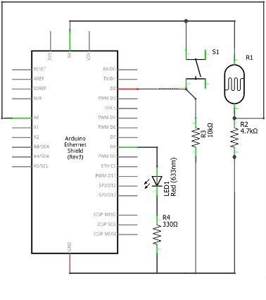
ETHERNET Exercise: Schematic
The LDR (R1) alongside with R2 form a voltage divider from which we will be taking analog voltage readings.
The switch (S1) will trigger an interrupt on GPIO pin 2 when clicked.
20

Slide 21
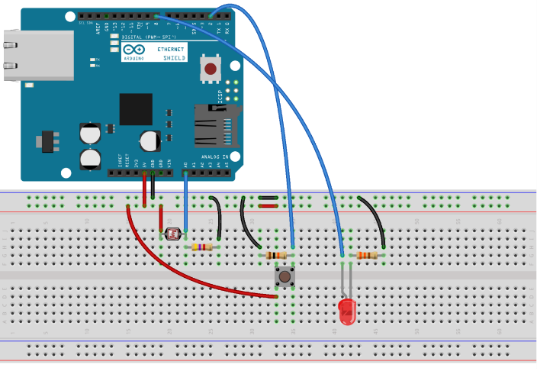
ETHERNET Exercise: Breadboard
The same circuit presented on a breadboard for easier prototyping.
21

Slide 22
Ethernet Exercise: Code (1)
// The Ethernet Shield uses SPI to communicate // with the Arduino board.
#include <SPI.h>
#include <String.h>
#include <Ethernet.h>
// Buffer will store the server’s response.
char buffer;
// Button is a flag variable.
bool button;
// Button and LED GPIO pins.
const byte GPIO_led = 8;
const byte GPIO_btn = 2;
// Request interval timer.
unsigned long request_timer;
// Server response timeout timer.
unsigned long timeout_timer;
// Your Ethernet Shield’s MAC address. Usually found on a sticker
// underneath the shield. If not available, enter your own.
byte mac[] = { 0xFF, 0xFF, 0xFF, 0xFF, 0xFF, 0xFF };
// The domain / server to connect to, and its port.
const char host[] = "spyrosrallis.com";
const byte port = 80;
// Unique device identifier. For the purpose of this exercise, a
// value between 0-255 is adequate.
const byte device = 1;
// The IP address that we’re going to request from the router. If
// using DHCP, this might not be required.
IPAddress ip ( xxx, xxx, xxx, xxx );
// Initialization of the EthernetClient object. Required for
// connecting to, and communicating through the network.
EthernetClient client;
22

Slide 23
Ethernet Exercise: Code (2)
void setup()
{ // Register GPIO_btn as an input and
// attach an interrupt to it to run on
// rising edge.
pinMode(GPIO_btn, INPUT);
attachInterrupt(digitalPinToInterrupt(2), button_click, RISING);
// Register GPIO_led as an output.
pinMode(GPIO_led, OUTPUT);
// Initialize the hardware UART with a // baud rate of 115200 bps.
Serial.begin(115200);
// Connect to the network.
Ethernet.begin(mac, ip);
Serial.print("Your IP Address is: ");
// Print the local IP. If you are behind a NAT
// router, this will print the NAT IP, not the // external IP.
Serial.print(Ethernet.localIP());
Serial.print("\r\n");
}
23

Slide 24
Ethernet Exercise: Code (3)
void loop() {
// Stop any previous connection kept-alive.
client.stop();
// Connect to the server.
client.connect(host, port);
// Upon successful connection send the request.
if ( client.connected() ) {
client.print((String)"GET / arduino/getdata.php?deviceid=" + String(device) + " HTTP/1.0\r\n"
+ "User-Agent: Arduino\r\n"
+ “Host: " + host + "\r\n"
+ "Connection: close\r\n\r\n");
// Store the time of the request.
timeout_timer = millis();
}
else {
Serial.println("Client not connected.");
return;
}
// While the server has not responded…
while ( !client.available()) {
if ( millis() > timeout_timer + 5000 )
{
// Request timed-out.
return;
}
// …wait for a response.
delay(10);
}
24

Slide 25
Ethernet Exercise: Code (4)
// If the server responded, read the response
// character-by-character. Only the last character
// will be stored in buffer.
while ( client.available() ) {
buffer = client.read();
}
// If the buffer is ‘1’, turn the LED on.
// Else, turn it off.
if (buffer == '1’) {
digitalWrite(GPIO_led, HIGH);
}
else {
digitalWrite(GPIO_led, LOW);
}
if ( button ) {
// Stop any previous connection kept-alive.
client.stop();
// Connect to the server.
client.connect(host, port);
// Upon successful connection send the request.
if ( client.connected() ) {
client.print((String)"GET /arduino/setdata.php?deviceid=" + String(device) + "&data=" + String(analogRead(A0)) + " HTTP/1.0\r\n"
+ "User-Agent: Arduino\r\n"
+ “Host: " + host + "\r\n"
+ "Connection: close\r\n\r\n");
}
25

Slide 26
Ethernet Exercise: Code (5)
else {
Serial.println("Client not connected.");
return;
}
button = false;
} // if ( button )
Ethernet.maintain();
delay(500);
} // loop()
void button_click(void)
{ // If more than 0.5s have elapsed from the // previous request, set the flag to true and // capture the current request time.
if (millis() > request_timer + 500)
{
request_timer = millis();
button = true;
}
}
26

Slide 27
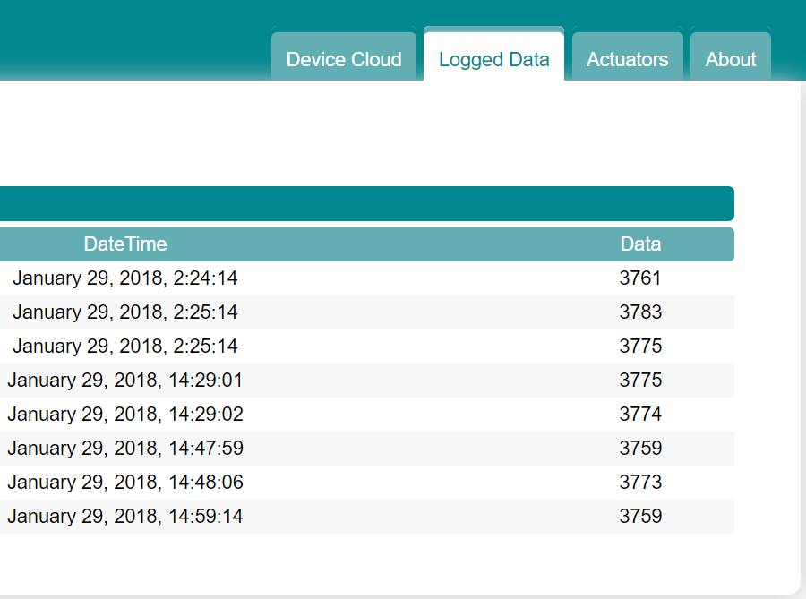
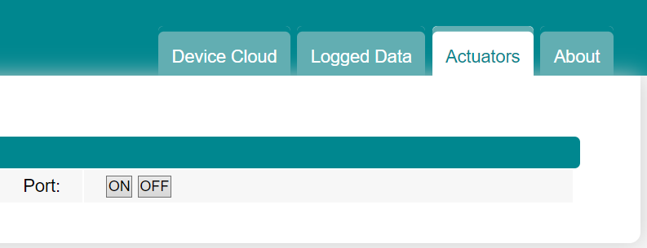
Ethernet Exercise: Conclusion
Upon successful completion of the
exercise, you should be able to see
the values from the LDR appearing on
The webpage every time you trigger
the interrupt by clicking the button.
Note that since the webpage does not
reload dynamically, you need to refresh
it by hand.
Also, you should be able to change
the status of the connected LED by
simply clicking the ‘ON’ / ‘OFF’ links
on the webpage under your client’s
name.
27

Slide 28
WiFi

Slide 29
WiFi - Introduction
WiFi is the most popular wireless communication protocol since it enables wireless access to the world of Internet, is free of charge and available at almost any public or private space. However, it is not so power effective for IoT applications running on batteries.
For interfacing Arduino with WiFi there is not a straightforward option, since the available WiFi Shield is rather expensive for it to be popular. The most popular alternative is based on the ESP8266 microcontroller, which is very affordable and reliable. But ESP8266 being a microcontroller by itself and not an Arduino peripheral, utilizing it as a WiFi extension for Arduino is possible, but quite tricky.
29

Slide 30
WiFi - Introduction
Instead, several ESP8266-based boards have been developed for facilitating communication via WiFi. Most of these boards are Arduino-friendly, which means that they can be programmed with the Arduino IDE after its extension with the required libraries.
Here we are going to use such a board, namely the ESP32 (which is the newer –and more promising- version of the ESP8266). Using this board we will enable bidirectional communication via WiFi with the same web application we used at the Unit of Ethernet.
30

Slide 31
WiFi Exercise: Description
This exercise, while not using an Arduino board, is very similar to the previous one (11(b)). This time we will use the ESP32-DEVKIT a WiFi-capable development board by doit.am.
The exercise follows the same scenario: upon pressing of a button we will be measuring the brightness levels produced from a LDR. The data will be sent to an HTTP server hosting a webpage specially designed for the exercise via a WiFi link. The user will have the option to control a LED connected to the ESP32-DEVKIT board from the webpage by clicking on the appropriate link.
31

Slide 32
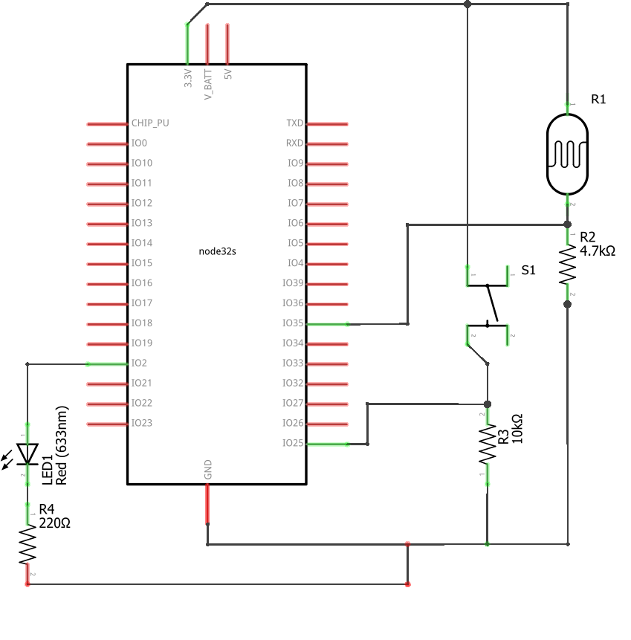
WiFi Exercise: Schematic
The LDR (R1) alongside with R2 form a voltage divider from which we will be measuring voltage levels. The switch (S1) will trigger an interrupt on GPIO pin 25 when clicked.
32

Slide 33
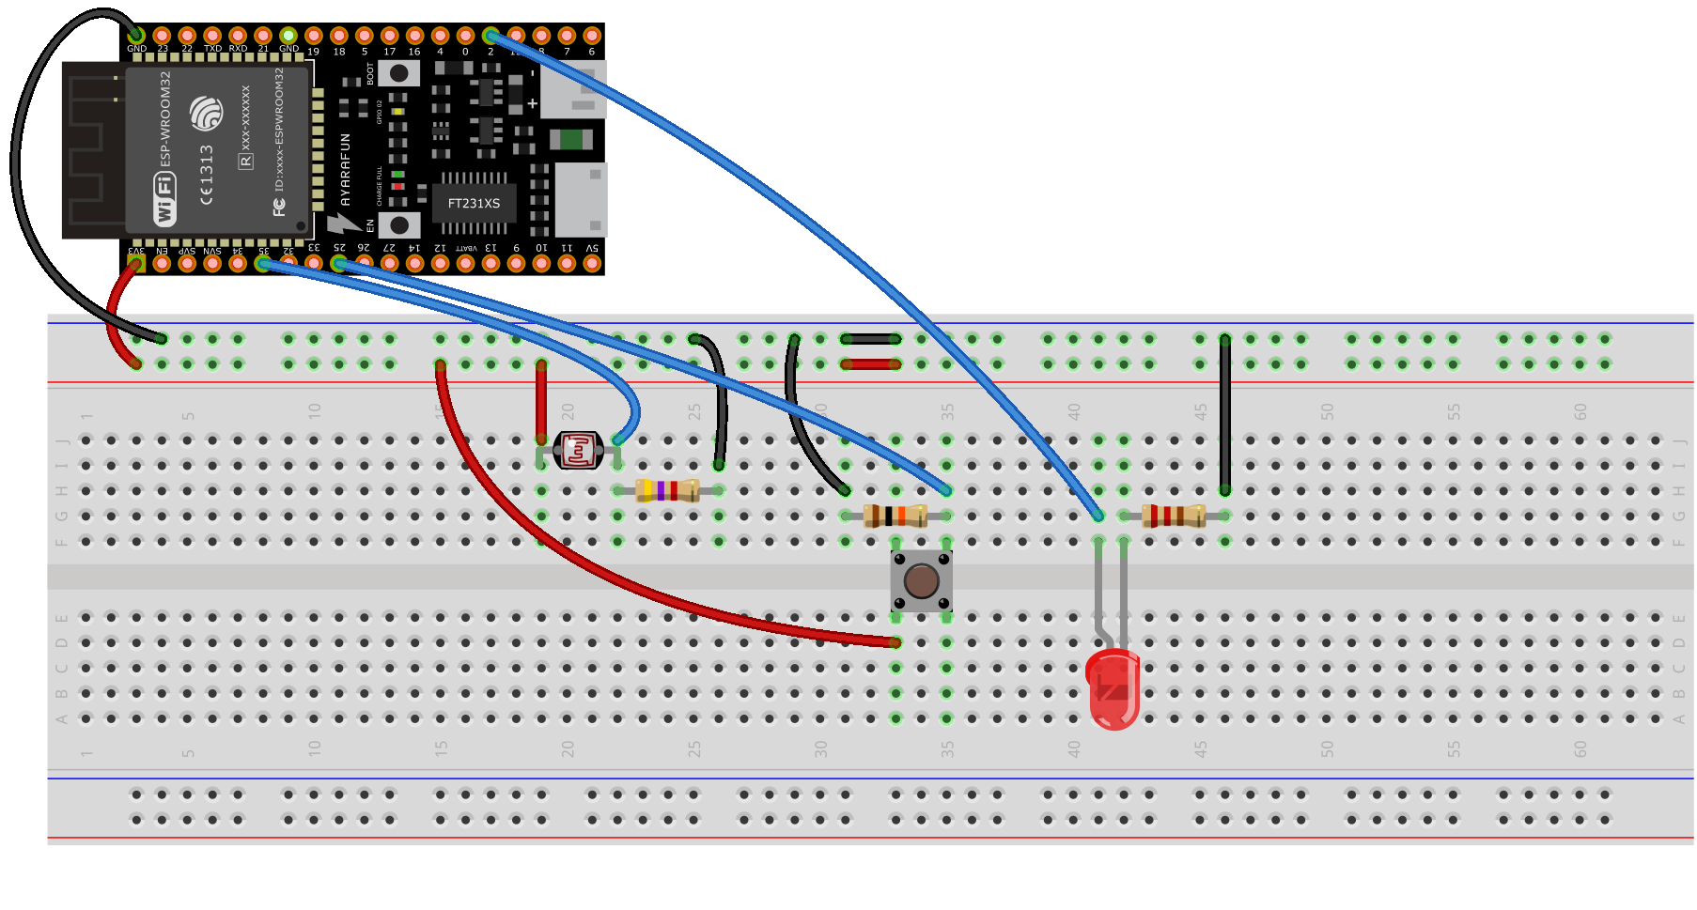
WiFi Exercise: Breadboard
The same circuit presented on a breadboard for easier prototyping. Note that since the ESP32-DEVKIT board comes equipped with male pin headers we will be needing male-to-female jumper cables.
33

Slide 34
WiFi Exercise: Code (1)
#include <WiFi.h>
// Buffer will store the server’s response.
char buffer;
// Button is a flag variable.
bool button;
// Button and LED GPIO pins.
const byte GPIO_led = 2;
const byte GPIO_btn = 25;
// Request interval timer.
unsigned long request_timer;
// Server response timeout timer.
unsigned long timeout_timer;
// The network’s SSID and password.
const char ssid[] = "ssid";
const char pass[] = "pass";
// The domain / server to connect to, and its port.
const char host[] = "spyrosrallis.com";
const byte port = 80;
// Unique device identifier. For the purpose of this
// exercise, a value between 0-255 is adequate.
const byte device = 1;
// Initialization of the WiFiClient object. Required for // connecting to, and communicating through the network.
WiFiClient client;
34

Slide 35
WiFi Exercise: Code (2)
void setup()
{// Register GPIO_btn as an input and attach an // interrupt to it to run on rising edge.
pinMode(GPIO_btn, INPUT);
attachInterrupt(digitalPinToInterrupt(GPIO_btn), button_click, RISING);
// Register GPIO_led as an output.
pinMode(GPIO_led, OUTPUT);
// Initialize the hardware UART with a baud rate // of 115200 bps.
Serial.begin(115200); // Print debugging info.
Serial.print("Connecting to ");
Serial.print(ssid);
Serial.print(" .");
// Attempt to connect to the WiFi network.
WiFi.begin(ssid, pass);
// While not connected, wait. Check every 0.5s.
while ( WiFi.status() != WL_CONNECTED )
{
delay(500);
Serial.print(".");
}
// Upon successful connection, print a message.
Serial.print("\r\n");
Serial.print("Connected succesfully! Your IP Address is: ");
// Print the local IP. If you are behind a NAT router, this // will print the NAT IP, not the external IP.
Serial.print(WiFi.localIP());
Serial.print("\r\n");
}
35

Slide 36
WiFi Exercise: Code (3)
void loop() {
// Stop any previous connection kept-alive.
client.stop();
// Connect to the server.
client.connect(host, port);
// Upon successful connection send the request.
if ( client.connected() ) {
client.print(String("GET ") + "/arduino/getdata.php?deviceid=" + String(device) + " HTTP/1.0\r\n"
+ "User-Agent: ESP32\r\n"
+ "Host: " + host + "\r\n"
+ "Connection: close\r\n\r\n");
// Store the time of the request.
timeout_timer = millis();
// While the server has not responded…
while ( !client.available()) {
if (millis() > timeout_timer + 5000) {
// Request timed-out. return;
}
// …wait for a response.
delay(10);
}
// If the server responded, read the response
// character-by-character. Only the last character
// will be stored in buffer.
while ( client.available() ) {
buffer = client.read();
}
36

Slide 37
WiFi Exercise: Code (4)
// If the buffer is ‘1’, turn the LED on. // Else, turn it off.
if (buffer == ‘1’) {
digitalWrite(GPIO_led, HIGH);
}
else {
digitalWrite(GPIO_led, LOW);
}
}
else
{
Serial.println("Connection failed.");
return;
} // if ( client.connected()
if ( button ) {
// Stop any previous connection kept-alive.
client.stop();
// Connect to the server.
client.connect(host, port);
// Upon successful connection send the request.
if ( client.connected() ) {
client.print(String("GET ") + "/arduino/setdata.php?deviceid=" + String(device) + "&data=" + analogRead(35) + " HTTP/1.0\r\n"
+ "User-Agent: ESP32\r\n"
+ "Host: " + host + "\r\n"
+ "Connection: close\r\n\r\n");
}
37

Slide 38
WiFi Exercise: Code (5)
else {
Serial.println("Connection failed.");
return;
}
button = false;
} // if ( button )
delay(500);
} // loop()
void button_click(void)
{
// If more than 0.5s have elapsed from the previous request, set the flag to true and capture the current request time.
if (millis() > request_timer + 500)
{
request_timer = millis();
button = true;
}
}
38

Slide 39
WiFi Exercise: Breadboard
You should now be able to see the values from the LDR appearing on the webpage every time you trigger the interrupt by clicking the button. Note that since the webpage does not reload dynamically, you need to refresh it by hand.
Also, you should be able to change the status of the connected LED by simply clicking the ‘ON’ / ‘OFF’ buttons on the webpage under your client’s name.
39

Slide 40
UNIT 14 Communication Protocols
Thank You

