Slide 1
UNIT 13
THE I2C BUS

Slide 2
Aim and Agenda of unit 12
Give the basic ideas and simple examples
for enable Arduino to communicate with any kind of device or peripheral
The aim of the presentation
The agenda of the presentation
Explain what is Communication and especially Serial Communication
Present Programming Communication Functions used in this unit (basic principles)
Present Programming Transmitting Data Functions used in this unit (basic principles)
Present Programming Receiving Data Functions used in this unit (basic principles)
Present Other General Purpose Functions
Practice Section
2

Slide 3
Introduction
Current controlers have circuits for bit by bit serial communications
USART
SSP
Comunnication Protocols
I2C
the 1-wire
3

Slide 4
I²C Protocol
Developed by Philips in the 90’s to connect up integrated circuits within single devices or household appliances
These days it’s universal
More information: http://www.nxp.com/products/interface_and_connectivity/i2c/
4

Slide 5
THE I2C BUS
Communication system that transfers data between components inside a computer or between computers.
Uses only two signals or pins to exchange information
NAME | DESCRIPTION
SCL | Serial clock line. It’s always output when used for the master or host and input for the slave.
SDA | Serial data line (bidirectional). The data can travel from the master to the slave or the other way around.
5

Slide 6
THE I2C BUS - FEATURES
It uses just two signals to transfer data: SCL and SDA.
They’re both open collector signals so they have to be connected to +V using two separate pull-up resistors.
Byte wise data transfer. 8 bits is the minimum for each word transferred.
“Multi-master” replication system. A single bus (SCL, SDA) may include several master or host controllers as well as several slaves.
All slave devices have an address assigned them during their manufacture; it differentiates them from other slaves on the bus.
A single bus cannot accommodate two slave devices with the same address.
The master or host uses this address to select the slave device it wants to communicate with.
6

Slide 7
THE I2C BUS - TERMINOLOGY
Bit transfer:
I²C protocol uses synchronous communication.
bit 1 or bit 0
Valid bit
Non-valid bit
7

Slide 8
THE I2C BUS - TERMINOLOGY
Start/Stop Condition:
The host initiates all transfers by sending a sequence or Start (S) condition and ends transfers with a Stop (P) condition.
8

Slide 9
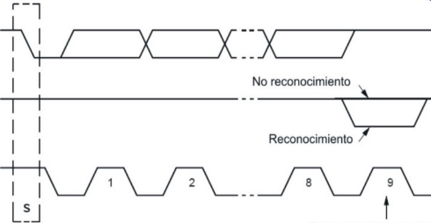
THE I2C BUS - TERMINOLOGY
The Acknowledge Bit:
No limitation on the number of bytes however each one must be followed by an Acknowledge bit or ACK/NACK .
Transmitter SDA
Negative acknowledgement
Receiver SDA
Master SDA
Acknowledgement
Clock tick for ACK acknowledgement bit]
9

Slide 10
THE I2C BUS - TERMINOLOGY
The I2C Transaction Frame:
All I2C transfers consist of a frame of one or more bytes.
10

Slide 11
THE I2C BUS - WIRE LIBRARY
Functions contained in this library manage the electronic circuits or hardware integrated in the Arduino controller to implement what we called “SSP” or Synchronous Serial. This library comes with the Arduino Integrated Development Environment (IDE)
The Wire.begin() FUNCTION
Syntax:Wire.begin(address)
address: Optional seven bit integer (between 0 and 128). If it isn’t indicated it is assumed that the device, in this case the Arduino UNO, will function as the master or host. Otherwise it is assumed that the Arduino UNO will function as a slave
On the Arduino UNO board pins A4 and A5 become SDA and SCL signals respectively and you must not connect any other sort of device to them
11

Slide 12
THE I2C BUS - WIRE LIBRARY
The Wire.beginTransmission() FUNCTION
Syntax:Wire.beginTransmission(address)
address: A seven bit integer (between 0 and 128) which represents the address of the device the slave wants to talk to.
The Wire.write() FUNCTION
Syntax:Wire.write(value)
Syntax:Wire.write(string)
Syntax:Wire.write(data,length)
value: a value to send as a single byte or eight bits
string: a chain of characters comprising several bytes
data: an array of data to be sent as bytes
length: the number of bytes to transmit
12

Slide 13
THE I2C BUS - WIRE LIBRARY
The Wire.endTransmission() FUNCTION
Syntax:Wire.endTransmission(mode)
mode: TRUE or FALSE. If true, endTransmission() sends a stop message after transmission, releasing the I2C bus. If false, endTransmission() sends a restart message (S) after transmission. This message is required by some I2C devices and is optional. The default value is true.
Returns: The function returns the following error codes for assessment:
0: success
1: data too long to fit in transmit buffer
2: received NACK on transmit of address
3: received NACK on transmit of data
4: other error
13

Slide 14
THE I2C BUS - WIRE LIBRARY
The Wire.requestFrom() FUNCTION
Syntax:Wire.requestFrom(address, quantity, mode)
address: a seven-bit integer (between 0 and 128) and represents the address of the device which bytes will be requested from.
quantity: number of bytes to be received.
mode: TRUE or FALSE. TRUE will send a stop message (P) after the request and reception of all the bytes, releasing the bus. FALSE will send a constant restart (S) after the request thus keeping the connection active. This message is required by some I²C devices and is optional. The default value is true.
14

Slide 15
THE I2C BUS - WIRE LIBRARY
The Wire.available() FUNCTION
Syntax:Wire.available()
The Wire.read() FUNCTION
Syntax:Wire.read().
The Wire.onReceive () FUNCTION
Syntax:Wire.onReceive(function).
function: registers the function to be called when a slave device receives a transmission from a master. This function usually reads the bytes that the master writes to it.
The Wire.onRequest () FUNCTION
Syntax:Wire.onRequest().
handler: function to be called every time the master requests data from it.
15

Slide 16
THE I2C BUS - WIRE LIBRARY
The Wire.available() FUNCTION
Syntax:Wire.available()
The Wire.read() FUNCTION
Syntax:Wire.read().
The Wire.onReceive () FUNCTION
Syntax:Wire.onReceive(function).
function: registers the function to be called when a slave device receives a transmission from a master. This function usually reads the bytes that the master writes to it.
The Wire.onRequest () FUNCTION
Syntax:Wire.onRequest().
handler: function to be called every time the master requests data from it.
16

Slide 17
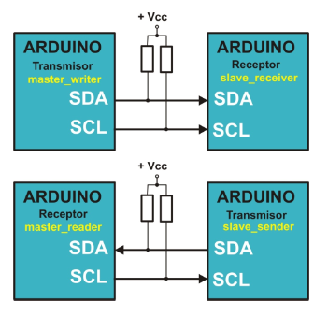
THE I2C BUS - WIRE LIBRARY
Before start:
Take a look of the examples that exist in this library:
master_writer: configures the Arduino as an I2C master device for transmitting data.
slave_receiver: configures the Arduino as a slave data receiver.
master_reader: configures the Arduino as a master data receiver.
slave_sender: configures the Arduino as an I2C master device for transmitting data.
17

Slide 18
THE I2C BUS - DEVICES
THE SRF02 ULTRASONIC RANGE FINDER
Operational Principles
From 20 KHz onwards.
A capsule emits an ultrasonic signal. This bounces off an object and creates an echo that goes back to the range finder. It then measures the time transpired between the signal and the echo.
Ultrasonic waves move at the speed of sound: 343 m/s through the air at sea level at a temperature of 20ºC and relative humidity of 50%.
Distance | Time | Description
1 cm | 0.00002915 “ = 0.02915 mS = 29.15 µS | (1 / 343) / 100
1 m | 0.002915 ” = 2.915 mS = 2915 µS | 1 / 343
1 Km | 2.915 “ = 2915 mS = 2915000 µS | (1 / 343) * 1000
18

Slide 19
THE I2C BUS - DEVICES
SRF02 - FEATURES AND CONNECTIONS
important features of the SRF02 ultrasonic rangefinder:
Range: from 16 cm to 6 m (in theory)
Power: + 5 V a 4 mA
Ultrasonic frequency: 40 MHz
Size: 24 mm x 20 mm x 17 mm
Analogue Gain: Automatic 64 step gain control
Connection Modes: 1 - Standard I2C Bus 2 - Serial Bus (connects up to 16 devices to any UART serial port)
Full Automatic Tuning: No calibration, just power up and go
Units: Range reported in µS, mm or inches.
The default shipped address of the SRF02 is 224 (0xE0). It can be changed by the user to any of 16 addresses: E0, E2, E4, E6, E8, EA, EC, EE, F0, F2, F4, F6, F8, FA, FC or FE, therefore up to 16 different addresses can be used.
19

Slide 20
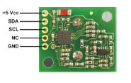
THE I2C BUS - DEVICES
SRF02 - FEATURES AND CONNECTIONS
The SRF02 functions as an I2C slave device and includes its own controller responsible for making measurements and calibrations and then transmitting them to the host controller
Pin | Name
1 | +5v Vcc | Voltage 5 V
2 | SDA | I2C bus data line
3 | SCL | I2C time line
4 | Mode | Left unconnected
5 | GND | Ground
20

Slide 21
THE I2C BUS - DEVICES
SRF02 - INTERNAL REGISTERS
A summary of the internal registers of the SRF02 appear in the table below:
Location | Read | Write
0 | INTERNAL VERSION OF I2C DEVICE FIRMWARE | COMMAND REGISTER
1 | UNUSED (READS 0X80) | N/A
2 | RANGE HIGH BYTE | N/A
3 | RANGE LOW BYTE | N/A
4 | AUTOTUNE MINIMUM - HIGH BYTE | N/A
5 | AUTOTUNE MINIMUM – LOW BYTE | N/A
21

Slide 22
THE I2C BUS - DEVICES
Command |  | Action
Decimal | Hex
80 | 0X50 | REAL RANGING MODE - RESULT IN INCHES
81 | 0X51 | REAL RANGING MODE - RESULT IN CENTIMETRES
82 | 0x52 | REAL RANGING MODE - RESULT IN MICRO-SECONDS
86 | 0X56 | FAKE RANGING MODE - RESULT IN INCHES
87 | 0x57 | FAKE RANGING MODE - RESULT IN CENTIMETRES
88 | 0x58 | FAKE RANGING MODE - RESULT IN MICRO-SECONDS
92 | 0x5C | TRANSMIT AN 8 CYCLE 40KHZ BURST - NO RANGING TAKES PLACE
96 | 0X60 | FORCE AUTOTUNE RESTART - SAME AS POWER-UP. YOU CAN IGNORE THIS COMMAND
160 | 0xA0 | 1ST IN SEQUENCE TO CHANGE I2C ADDRESS
165 | 0xA5 | 3RD IN SEQUENCE TO CHANGE I2C ADDRESS
170 | 0xAA | 2ND IN SEQUENCE TO CHANGE I2C ADDRESS
22

Slide 23
THE I2C BUS - DEVICES
Real ranging:
measures the distance of an object from the SRF02. The device emits an 8 cycle ultrasonic burst at 40 KHz. It then waits to receive an echo - if there is one, that is.
Fake ranging:
xxx
Burst:
Bursts don’t perform any measurement. It’s used as a warning signal or a synchroniser in an environment where there are several SRF02 sensors.
Restart
it performs the initial tasks of adjustment and calibration.
23

Slide 24
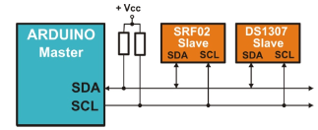
THE I2C BUS - DEVICES
THE DS1307 REAL-TIME CLOCK AND CALENDAR
contains a real-time clock and calendar.
24

Slide 25
THE I2C BUS - DEVICES
THE DS1307 REAL-TIME CLOCK AND CALENDAR
Features:
It contains a real-time clock and calendar. The clock/calendar provides seconds, minutes, hours, day, date, month, and year information.
It includes corrections for leap years to the year 2099.
It contains 56 bytes of NV SRAM or Non volatile RAM memory powered by an external Non volatile battery.
I2C interface with the host or master.
Programmable square-wave output signal.
The DS1307 has a built-in power-sense circuit that detects power failures and automatically switches to the backup supply.
Low power operation extends battery backup run time and consumes less than 500nA in battery backup mode with oscillator
8-Pin DIP and 8-Pin SO minimizes required space.
25

Slide 26
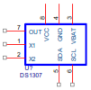
THE I2C BUS - DEVICES
THE DS1307 REAL-TIME CLOCK AND CALENDAR
Enclosure and PIN-OUT:
Nº | Name | Description
1 | X1 | the input to the oscillator and is connected to an external quartz crystal 32.768kHz oscillator.
2 | X2 | the output to the oscillator and is connected to an external quartz crystal 32.768kHz oscillator.
3 | VBAT | Backup supply input for any standard 3V lithium cell or other energy source.
4 | GND | The earth for the main power supply
5 | SDA | Serial Data Input/Output. Input/output for the I2 C serial interface.
6 | SCL | Serial Clock Input. SCL is the clock input for the I2C interface
7 | SQWE/OUT | Square wave/output driver.
8 | VCC | Primary +5V power supply.
26

Slide 27
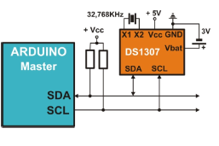
THE I2C BUS - DEVICES
THE DS1307 REAL-TIME CLOCK AND CALENDAR
Internal Registers:
27

Slide 28
THE I2C BUS - DEVICES
THE DS1307 REAL-TIME CLOCK AND CALENDAR
Internal Registers:
Address | Bit 7 | Bit 6 | Bit 5 | Bit 4 | Bit 3 | Bit 2 |  | Bit 1 | Bit 0 |  | Function |  |  |  | Range
0 | CH | 10 seconds |  |  |  |  | Seconds |  |  |  |  |  |  | Seconds |  |  |  | 00-59
1 | 0 | 10 minutes |  |  |  |  | Minutes |  |  |  |  |  |  | Minutes |  |  |  | 00-59
2 | 0 | 12 | PM/AM | 10 hours | Hours |  |  |  |  |  |  |  | Hours |  |  |  |  |  |  | 1-12
 |  | 24 | 10 hours |  |  |  |  |  |  |  |  |  |  |  |  |  |  |  |  | 00-23
3 | 0 | 0 | 0 | 0 | 0 | DAY |  |  |  |  |  | Day |  |  |  |  | 01-07
4 | 0 | 0 | 10 Date |  | Date |  |  |  |  |  |  |  | Date |  |  |  |  |  |  | 01-31
5 | 0 | 0 | 0 | 10 month | Month |  |  |  |  |  |  |  | Month |  |  |  |  |  |  | 01-12
6 | 10 Year |  |  |  |  |  |  |  |  | Year |  |  |  |  | Year |  |  |  | 00-99
7 | OUT | 0 | 0 | SQWE | 0 | 0 |  | RS1 | RS0 |  | Control |  |  |  | -­
8-63 | 56 registers for data |  |  |  |  |  |  |  |  |  |  |  |  |  |  | RAM |  |  |  |  | 0-255
28

Slide 29
THE I2C BUS - DEVICES
THE DS1307 REAL-TIME CLOCK AND CALENDAR
Internal Registers :
OUT/SQWE PIN | SQWE Bit | OUT Bit | RS1 Bit | RS0 Bit
1 Hz | 1 | X | 0 | 0
4096 Hz | 1 | X | 0 | 1
8192 Hz | 1 | X | 1 | 0
32768 Hz | 1 | X | 1 | 1
0 | 0 | 0 | X | X
1 | 0 | 1 | X | X
DIGIT | 0 | 1 | 2 | 3 | 4 | 5 | 6 | 7 | 8 | 9
BCD | 0000 | 0001 | 0010 | 0011 | 0100 | 0101 | 0110 | 0111 | 1000 | 1001
29

Slide 30
THE I2C BUS - DEVICES
THE DS1307 REAL-TIME CLOCK AND CALENDAR
Internal Registers Examples:
the time is 00:45:18
the time is 21:35:23…
Monday is the 1st day of the week, we’re up to Thursday 12 March 2015…
The SQW/OUT pin to go to logic level “1”.
send an 8192 Hz square-wave signal on the SQW/OUT pin
Register number | BCD Binary | Dec. | Hex.
30

Slide 31
THE I2C BUS - DEVICES
THE DS1307 REAL-TIME CLOCK AND CALENDAR
Information Frames Examples:
The master writes on the DS1307
The master reads from the current register of the DS1307
31

Slide 32
THE I2C BUS - DEVICES
THE DS1307 REAL-TIME CLOCK AND CALENDAR
Information Frames Examples:
The master reads from a predetermined internal register of the DS1307
32

Slide 33
THE I2C BUS - DEVICES
THE DS1307 THE DS1307 LIBRARY
The setRegister() FUNCTION:
Syntax: setRegister(n, value).
n: the number of the internal register of the DS1307 to be written (between 0 and 63).
value: this is the value to be saved in the selected register (between 0 and 255).
The setBCDtoRegister() FUNCTION:
Syntax: setBCDtoRegister (n, value).
n: the number of the internal register of the DS1307 to be written (between 0 and 63).
value: the BCD value to be saved in the selected register (between 0 and 99).
33

Slide 34
THE I2C BUS - DEVICES
THE DS1307 THE DS1307 LIBRARY
The getRegister() FUNCTION:
Syntax: getRegister(n).
n: the number of the internal register of the DS1307 to be read (between 0 and 63).
The resume() FUNCTION:
Syntax: resume ().
The standby() FUNCTION:
Syntax: standby ().
34

Slide 35
THE I2C BUS - DEVICES
THE DS1307 THE DS1307 LIBRARY
The getDate() FUNCTION:
Syntax: getDate(buffer).
buffer: seven position byte array that carries the date and time contained in the DS1307:
Buffer | Description
Buffer[0] | seconds (0-59)
Buffer[1] | minutes (0-59)
Buffer[2] | hours (1-12 o 0-23)
Buffer[3] | day of the week (1-7)
Buffer[4] | day of the month (1-31)
Buffer[5] | month (1-12)
Buffer[6] | year (0-99)
35

Slide 36
THE I2C BUS - DEVICES
THE DS1307 THE DS1307 LIBRARY
The setSeconds() FUNCTION:
Syntax: setSeconds(v).
v: the new value for the seconds between 0 and 59.
The setMinutes() FUNCTION:
Syntax: setMinutes(v).
v: the new value for the minutes between 0 and 59.
The setHours() FUNCTION:
Syntax: setHours(v).
v: the new value for the hours between 1 and 12 or 0 and 23.
36

Slide 37
THE I2C BUS - DEVICES
THE DS1307 THE DS1307 LIBRARY
The setDow() FUNCTION:
Syntax: setDow(v).
v: the new value for the day of the week between 1 and 7.
The setData() FUNCTION:
Syntax: setData(v).
v: the new value for the day of the month between 1 and 31.
The setMonth () FUNCTION:
Syntax: setMonth(v).
v: the new value for the month between 1 and 12.
The setYear() FUNCTION:
Syntax: setYear(v).
v: the new value for the day of the week between 0 and 99.
37

Slide 38
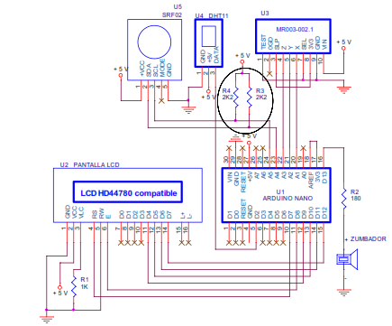
THE I2C BUS – PRACTICE SECTION
EXAMPLE 1: A VERSION OF FIRMWARE
The version of firmware that controls the SRF02 ultra sonic range finder is displayed on the LCD.
38

Slide 39
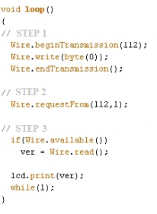
THE I2C BUS – PRACTICE SECTION
EXAMPLE 1: A VERSION OF FIRMWARE
The A5 and A4 analogue inputs also behave like SCL and SCD signals respectively on the Arduino UNO I2C bus. They’re connected to the R3 and R4 pull-up resistors and the SCL and SDA pins on the SRF02 ultra sonic range finder
39

Slide 40
THE I2C BUS – PRACTICE SECTION
EXAMPLE 2: DISTANCE
The screen will display the distance in centimetres between the range finder and an object.
Step 1: Communication with the SRF02 Slave is enabled by selecting the command register No. 0 and writing the value 81. This command initiates a new measurement of the distance in centimetres.
Step 2: The waiting cycle. The SRF02 requires a minimum of 65 mS to complete the measurement.
Step 3: Select the first register and save the result of the measurement. The most significant byte is stored in register No. 2 and the least significant one in No. 3.
40

Slide 41
THE I2C BUS – PRACTICE SECTION
EXAMPLE 3: MORE DISTANCES
The SRF02 will provide results in centimeters, inches and microseconds and they’ll be displayed on the LCD screen.
medir(cm): Performs the measurement in centimeters.
medir(in): Performs the measurement in inches.
medir(uS): Performs the measurement in microseconds.
Have close look at this extract from a program:
measure(in);
lcd.setCursor(13,0);
n=lcd.print(distance);
for(n; n<3; n++)
lcd.print(" "); //Complete with blank space
41

Slide 42
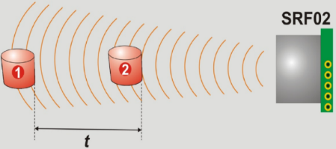
THE I2C BUS – PRACTICE SECTION
EXAMPLE 4: COLLISION AVOIDANCE SYSTEM
Detect the distance between the SRF02 ultrasonic range finder and an object or obstacle. As the object gets closer and closer to the SRF02 and passes certain minimum distances the piezo-electric buzzer connected to the D13 output pin starts to emit a warning signal at different frequencies.
EXAMPLE 5: SPEED DETECTOR
This exercise is purely experimental and while it’s not easy to check its accuracy it can give you a basic idea of what a speed detector is like.
42

Slide 43
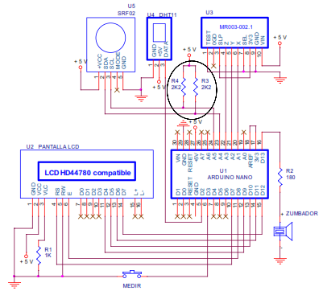
THE I2C BUS – PRACTICE SECTION
EXAMPLE 6: AREA METRE
These metres are able to use ultrasound or laser light to measure distances. In this case, of course we’ll be using the SRF02 ultrasonic range finder.
43

Slide 44
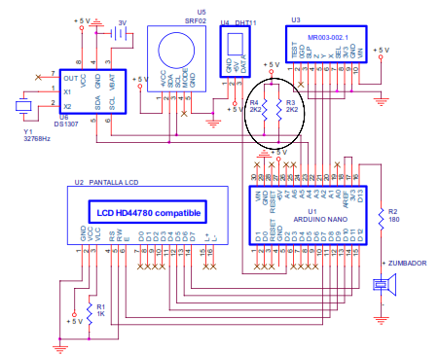
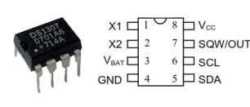
THE I2C BUS – PRACTICE SECTION
EXAMPLE 7: REAL-TIME CLOCK
read the first seven internal registers to get the hours, minutes and seconds and then display them in real time.
44

Slide 45
THE I2C BUS – PRACTICE SECTION
EXAMPLE 8: CLOCK AND CALENDAR PART 1
This exercise is just like a continuation of the previous one: the date and the time are displayed on the LCD screen. Two new functions have been created to make this possible; you’ll be able to use them in future projects too: visuDate() and visuTime().
45

Slide 46
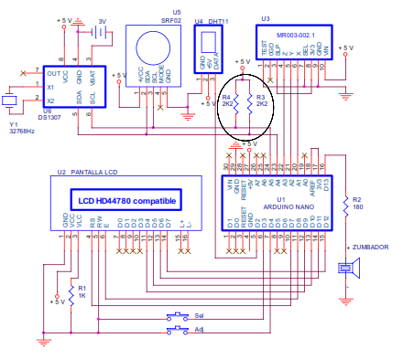
THE I2C BUS – PRACTICE SECTION
EXAMPLE 9: CLOCK AND CALENDAR PART 2
This example uses the previous visuDate() and visuTime() functions to run a real-time clock and calendar; you can also adjust any of the following fields: day of the week, day of the month, month, year, hours and minutes.
46

Slide 47
THE I2C BUS – PRACTICE SECTION
EXAMPLE 10: BILLBOARD
You’re going to get into the DS1307 real-time clock and calendar to get the date and the time out by using the I2C protocol. You’re also going to communicate with the DHT11 sensor from the previous unit to the get the room temperature and the relative humidity by using the 1-wire protocol.
EXAMPLE 11: BILLBOARD
It sends a record of the date, time, humidity and temperature at regular intervals using serial communication.
47

Slide 48
UNIT 13 THE I2C BUS
Thank You

