Slide 1
UNIT 12
SERIAL INTERFACE

Slide 2
Aim and Agenda of unit 12
Give the basic ideas and simple examples
for enable Arduino to communicate with any kind of device or peripheral
The aim of the presentation
The agenda of the presentation
Explain what is Communication and especially Serial Communication
Present Programming Communication Functions used in this unit (basic principles)
Present Programming Transmitting Data Functions used in this unit (basic principles)
Present Programming Receiving Data Functions used in this unit (basic principles)
Present Other General Purpose Functions
Practice Section
2

Slide 3
Communication
Serial Communication in Arduino is called UART serial communication
Two wires: Tx (for data transmittion) and RX (for its reception).
3

Slide 4
Programming - Communication Functions
Establishing Communication
The Serial.begin() FUNCTION
Syntax: Serial.begin(bauds, SERIAL_NPS)
bauds: Sets the data rate in bits per second (baud) for serial data transmission.
SERIAL_NPS: Optional. Enable the configuration of character encoding:
N=Nº of bits per character: 5, 6, 7 or 8 (default value)
P=Parity: E= even, O= odd N=sin parity (default value)
S=Nº of stop bits at the end of the character: 2 or 1 (default value
The Serial.end() FUNCTION
Syntax: Serial.end()
4

Slide 5
Programming - Transmitting Data Functions
Transmitting Data
The Serial.print() FUNCTION
Syntax1: Serial.print(value)
value: the value to print - any data type.
Syntax2: Serial.print(value,format)
value: the value to print - any data type.
format: specifies the number base for integral data types or number of decimal places for floating point types.
The Serial.println() FUNCTION
5

Slide 6
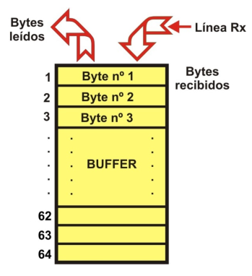
Receiving Data
Bytes read
Rx line
Bytes received
6

Slide 7
Programming – Receiving Data Functions
Transmitting Data
The Serial.available() FUNCTION
Syntax: Serial.available()
The Serial.read() FUNCTION
Syntax: Serial.read()
The Serial.parseInt() FUNCTION
Syntax: Serial.parseInt()
The Serial.parseFloat() FUNCTION
Syntax: Serial.parseFloat()
7

Slide 8
Programming – Other General Purpose Functions
The pulseIn() FUNCTION
Syntax: pulseIn(pin, level, time)
pin: the number of the input pin you want to read the pulse on. (int)
value: type of pulse to read: either the level “1” signal or the level “0” signal. (int)
timeout (optional): the number of microseconds to wait for the pulse to be completed: the function returns 0 if no complete pulse was received within the timeout.
8

Slide 9
Programming – Other General Purpose Functions
The min() AND max() FUNCTIONS
Syntax: min(A, B)
Syntax: max(A, B)
A: the first number, any data type
B: the second number, any data type
The abs() FUNCTION
Syntax: abs(n)
n: the number.
9

Slide 10
Programming – Other General Purpose Functions
The pow() FUNCTIOIN
Syntax: pow(base,exponent)
base: the number (float)
exponent: the power to which the base is raised (float)
The sqrt() FUNCTION
Syntax: sqrt(n)
n: the number, any data type.
The sin(), cos(), tan() FUNCTIONS
Syntax: sin(n)
Syntax: cos(n)
Syntax: tan(n)
n: this is the value of the angle in radians
10

Slide 11
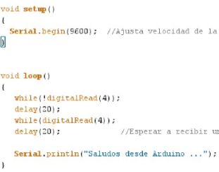
PRACTICE SECTION
EXAMPLE 1: Saying hello
11

Slide 12
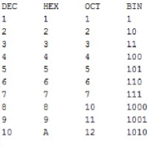
PRACTICE SECTION
EXAMPLE 2: Numbering systems
12

Slide 13
PRACTICE SECTION
EXAMPLE 3: Calculator
To simulate a calculator capable of performing: addition, subtraction, multiplication and division of two integers. There are basically two interesting aspects to the exercise:
The communication is two way
Creation and use of a function
13

Slide 14
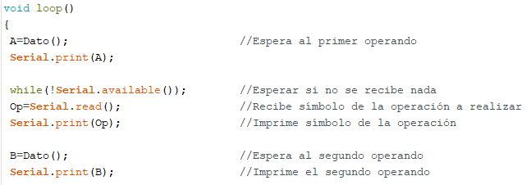
PRACTICE SECTION
EXAMPLE 3: Calculator (cont.)
An extract of the same program that calls the function
14

Slide 15
PRACTICE SECTION
Recommendations and advice for designing and making your own functions:
Define and write your functions at the beginning of the program, even before the main void loop() function.
You can’t use a function without previously defining it.
The name of a function, has to always begin with a letter; there can’t be any blank spaces either.
All the functions contained in the function you create have to be enclosed in square brackets ({…}).
The function type declaration and return type of the function must be the same type.
The return() function terminates your function.
A function can also have input. These parameters are “passed on” from the main program that calls up the function.
The main program or a function can use and “call up” another function and execute all the instructions it contains as many times as may be necessary.
15

Slide 16
UNIT 12 COMMUNICATIONS
Thank You

