Slide 1






UNIT 11: RC-SERVOMOTOR CONTROL

Slide 2


Aim and Agenda of unit 11
Give the basic ideas and simple examples
for driving rc-servomotors with Arduino
The aim of the presentation
The agenda of the presentation
Explain what is an rc-servomotor
Analyze the anatomy of an rc-servomotor
Give information about the several types of rc-servomotors
Explain the idea of the Pulse Width Modulation (PWM) signal
Give the basic control scheme of an RC-servo motor
Utilize the “SERVO” Library to Control the rc-servomotor
2

Slide 3
The anatomy of an rc-servomotor
SHAFT
GEAR TRAIN
DC MOTOR
CONTROLS
These mechanisms are similar to a conventional motor but they are able to make turns or controlled movements in any direction and in any position within their operational range. They are used in robotics and manufacturing: to move and turn a robot’s arm, to open and close a valve, to move an implement or tool, to position an object and many other applications.
3

Slide 4
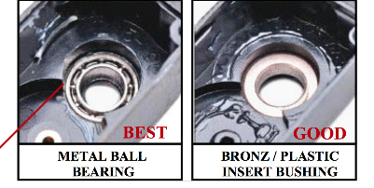
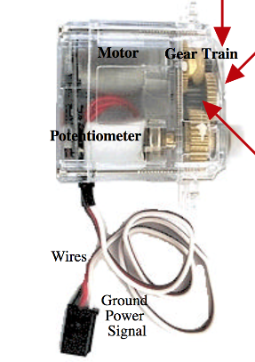
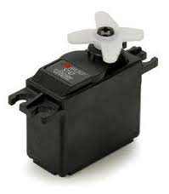
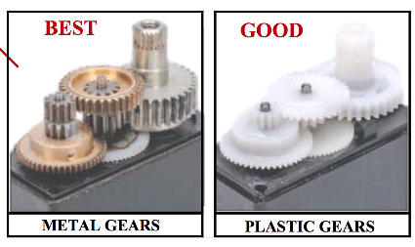
Servo Components: Best vs Good Parts
4

Slide 5
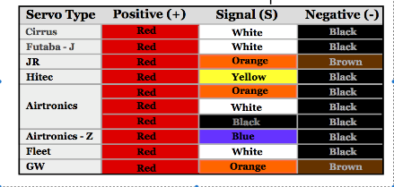
Types of rc-servo wire codes
We need only three leads to connect up our servo. We connect the black lead to the GND port or the 0 V power port and the red one to the +5 V power port. The PWM control signal goes through the white lead. Our Arduino will generate this signal of course.
You’ll find lots of manufacturers, types and models of servos. There are different sizes, strengths or torques, speeds, supply voltages, types of shafts and travels. There are servos with shafts that can rotate freely and others with shafts that can only rotate a certain number of degrees. The one we’re going to use in these exercises can rotate 180º.
The servo is controlled by sending a PWM signal through the Signal cable.
5

Slide 6
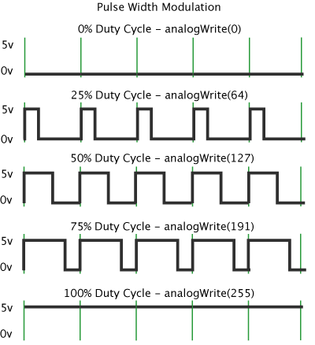
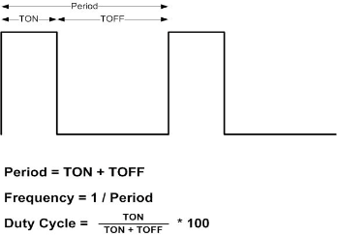
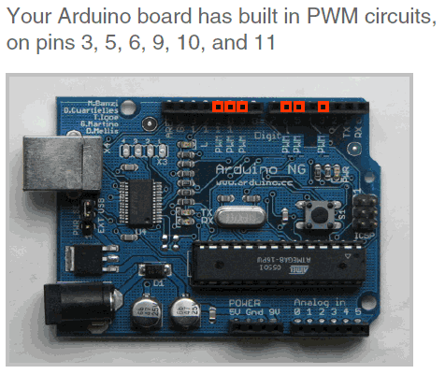
Explain the PWM signal (Pulse Width Modulation)
Arduino lacks a true analog output
PWM is a technique of rapidly pulsing the power on and off
Use Pulse-width modulation (PWM) to simulate a variable DC supply voltage
Arduino Uno has 6 PWM pins: 3, 5, 6, 9, 10, 11
Command: analogWrite(pin, value)
value is duty cycle: between 0 and 255
Examples:
  analogWrite(9, 256*1/2) for a 50% duty cycle
  analogWrite(11, 256*1/4) for a 25% duty cycle
PWM, or pulse width modulation is a technique which allows us to adjust the average value of the voltage that’s going to the electronic device by turning on and off the power at a fast rate. The average voltage depends on the duty cycle, or the amount of time the signal is ON versus the amount of time the signal is OFF in a single period of time.

Slide 7
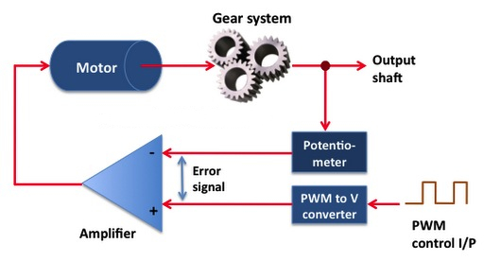
Control the rc-servomotor with a PWM signal (Pulse Width Modulation)
The servo is controlled by sending a PWM signal through an appropriate pin of arduino. The duty cycle of the signal determines the position the shaft moves to or its rotation. It’s essential to follow the guidelines supplied by each particular model’s manufacturer but here’s an example in the figure below that may be of use.

Slide 8
Control the rc-servomotor with the “SERVO” Library
The library is called “Servo”. It’s a file called “Servo.h” provided by Arduino; it installed itself automatically with the IDE or Integrated Development Environment. In other words, it’s already in your computer.
If you include this file in your programs, you’ve enriched the Arduino programming language by integrating new functions in it.
Functions that are utilized by the “SERVO” library for Arduino #include <servo.h>
servo my_servo_1 Assign a name to your servo
my_servo_1.attach (pin, min, max) Assign the pin you are going to connect the servo with min and max duty cycle)
my_servo_1.writeMicroseconds(uS) Generates a PWM signal with a duty cycle in microseconds (uS) that will set the angle of the servo’s shaft
my_servo_1.write(value) Move servo in the angle value between 0º and 180º
my_servo_1.read() This function reads the current angle of the servo’s shaft which is actually the value passed to the last call to write()
my_servo_1.attached() This function checks whether or not the Servo variable is attached to a pin. It returns a “true” or “false”.
my_servo_1.detach() This function detaches the Servo variable from its pin.
Notes:
To control the stepper, apply voltage to each of the coils in a specific sequence. The sequence would go like this:
Change the polarity of the coils with a predefined way, bear in mind the basic idea we described at the beginning of the lecture
BIPOLAR exert more torque for the same current, it is prefared, but more complicated circuit
Same circuit
Same programm

