Slide 1






UNIT 10: DRIVING MOTORS

Slide 2
The aim and the Agenda of unit 10
Give the basic ideas and simple examples
for driving DC and Stepper motors with Arduino
The aim of the presentation
The agenda of the presentation
Explain what is an actuator and especially an electric motor
Present what kind of motors we use in this unit (basic principles)
Give the basic driving scheme of an electric motor
Present preliminary basic knowledge (TR, PWM)
DC motor drive with a TR, {control motor speed} (1 Example)
DC motor drive with an H-Bridge, {control direction and speed} (2 Examples)
Stepper motor drive with two H-Bridges {control direction position and speed} (2 Examples)

Slide 3
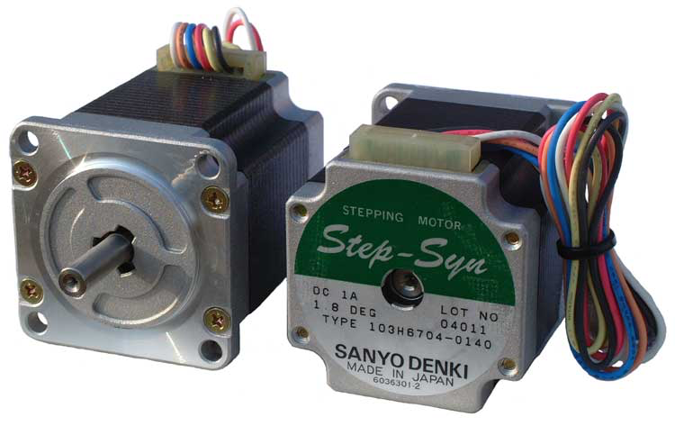
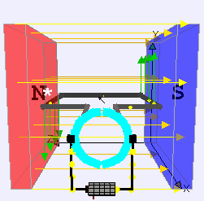
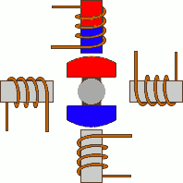
Preliminaries: Basic principles
DC Motor
Stepper Motor
(only two terminals)
(four, sir or eight terminals)
Moving in steps
An actuator is a component of a machine that is responsible for moving a mechanism. In other words is the mechanism by which a control system acts upon an environment.
An electric motor is an actuator, especially converts electrical energy into mechanical energy. Most electric motors operate through the interaction between an electric motor's magnetic field and winding currents to generate force and eventually torque to the shaft of the motor.
Explain what is an actuator and especially the electric motor

Slide 4
Preliminaries: The basic scheme for driving and controlling a motor
In general, we cannot drive a motor directly from the μ-controller pins
(max output current 40mA)
A motor driver is a little current amplifier; the function of motor drivers is to take a Low-Current Control Signal (LCCS) and then turn it into a Higher-Current Signal (HCS) that can drive a motor.
Motor Driver
Speed/position
command
μ-controller
LCCS
motor
HCS
Speed/
position
DIR
Feedback (optional)
Open loop or closed loop control

Slide 5
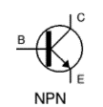
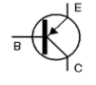

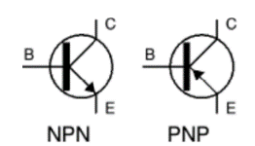




Preliminaries: Bipolar Junction Transistor (BJT) as an electronic switch
Transistor acts like a switch controlled with the base current
Switch: Normal Open
Switch: Normal Close
Τhe transistor acts just like a switch: apply or remove current, and the transistor (switch) turns on or off. In order to do its work as a motor control switch, the transistor needs a few extra common electronic components, specifically, a resistor and a diode. The purpose of these are described shortly :

Slide 6
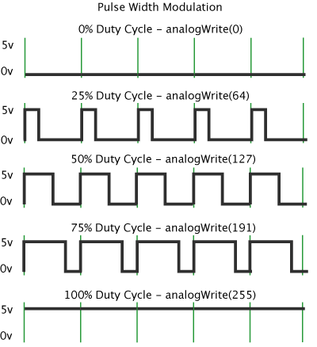
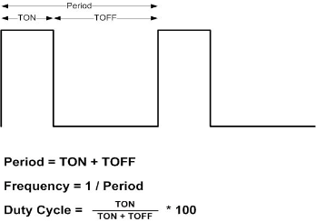
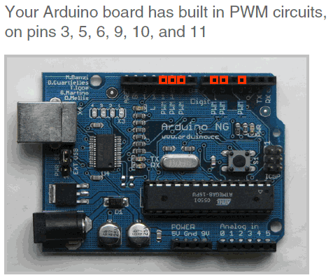
Preliminaries: The idea of a PWM signal (Pulse Width Modulation)
Arduino lacks a true analog output
PWM ia a technique of rapidly pulsing the power on and off
Use Pulse-width modulation (PWM) to simulate a variable DC supply voltage
Arduino Uno has 6 PWM pins: 3, 5, 6, 9, 10, 11
Command: analogWrite(pin, value)
value is duty cycle: between 0 and 255
Examples:
  analogWrite(9, 256*1/2) for a 50% duty cycle
  analogWrite(11, 256*1/4) for a 25% duty cycle
PWM, or pulse width modulation is a technique which allows us to adjust the average value of the voltage that’s going to the electronic device by turning on and off the power at a fast rate. The average voltage depends on the duty cycle, or the amount of time the signal is ON versus the amount of time the signal is OFF in a single period of time.

Slide 7
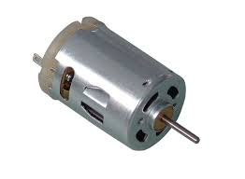
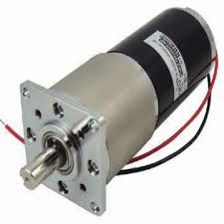
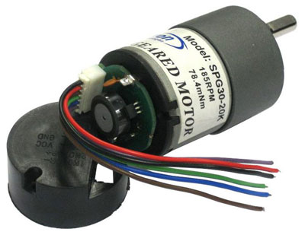
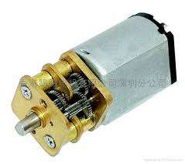
Priving DC Permanent Magnet motors
DC (PM)
motor

Slide 8
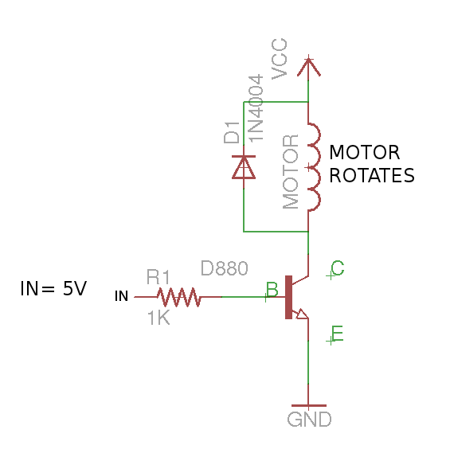
Typical driving circuit with NPN-type Transistor (basic idea)
Control of a motor is done using a transistor. The circuit starts and stops the motor, depending on the input signal.
The Selection of the resistor is such that the transistor switches fully on when the input signal is applied. A a result the motor should turn at almost full speed.
The motor rotates in one direction
A relay can also be used to electronically turn a motor on and off. You control the operation of the relay by applying 0 or 5 volts as a control voltage.

Slide 9
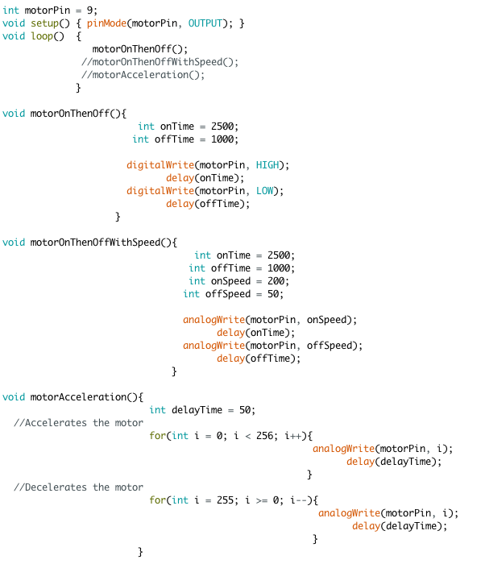
Example 1: DC motor drive with the NPN Transistor
Step 1
Step 2
Step 3
Changing the direction of the motor is only a little more difficult

Slide 10
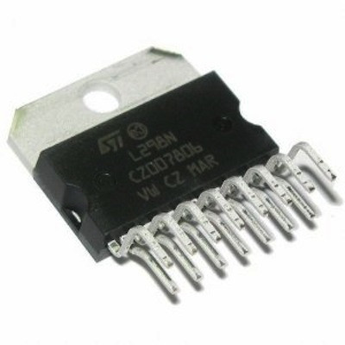
Typical driving circuit with the H-Bridge (basic idea)
Enables you to control the motor in both forward and reverse with a microcontroller.
Closing switches S1-S4 causes current to flow through the motor in one direction, making the motor spin clockwise
Closing switches S2-S3 causes current to flow through the motor in the opposite direction, making the motor spin counterclockwise.
Switches are replaced by transistors, so a monolithic integrated circuit (IC) is used (L293D,L298). ICs can be incorporated in a simple printed circuit board (PCB) or as a shield for Arduino.
H-bridge acts as a current amplifier, also can be used to drive coils
The speed of the DC motors is controlled using PWM signals,
L293D, max 0.6A
max 36 volts
L298 (2A Dual Motor Driver)
max 46 volts
max 2A
Temperature Sensor
Current sensor
Several commercial products
Notes:
Transition [==>] L293D

Slide 11
DC motor drive with the IC L293D (2x H-Bridge)
The IC L293D incorporates two H-bridge circuits with all the necessary electronics to drive two dc motors or one step motor.
Motor 1
Enable | Input 1 | Input 2 | Motor Action
LOW | either | either | Low stop
HIGH | LOW | LOW | Brake
HIGH | LOW | HIGH | forward
HIGH | HIGH | LOW | backword
HIGH | HIGH | HIGH | Brake
PWM | LOW | LOW | Pulse Brake
PWM | LOW | HIGH | Forward-spd
PWM | HIGH | LOW | Backword-spd
PWM | HIGH | HIGH | Pulse Brake
Vcc = 5 volt (IC pin 16)
Motor voltage = 4.5 ~ 36 volt
GND = (IC pins 4, 5, 12, 13)
IC pin 2 (Enable1)→controlled by Arduino Pin 3
IC pin 2 (Input1)→controlled by Arduino Pin 4
IC pin 7 (Input 2)→controlled byArduino Pin5
Notes:
Transition [==>] Connect L293D with the Arduino (example 2)

Slide 12

Example 2: DC motor drive with the IC L293D (2x H-Bridge)
5v
Arduino Pin 3 = Enalbe1
Arduino Pin 4 = Input1
max 0.6 A/ motor
Step 1
Arduino Pin 5 = Input2
9v
9v
Step 2
max 36 volts
max 2 A/ motor
Step 3
max 46 volts
Step 4
Step 5
Modifications:
a) use potentiometer to regulate velocity
b) use pcb based L298 Dual H-bridge
Step 6
Notes:
Transition [==>] Use some products in the market that are based on

Slide 13
Typical motor driver board based on L298 Dual H-bridge
The connections to Arduino board are exactly the same
Motor1
+,-
Enalbe1
Input1
Input2
Vmotor
Notes:
Transition [==>] there are several successful commercial products that are based on H-bridge ICs or shields that eliminates the connections

Slide 14
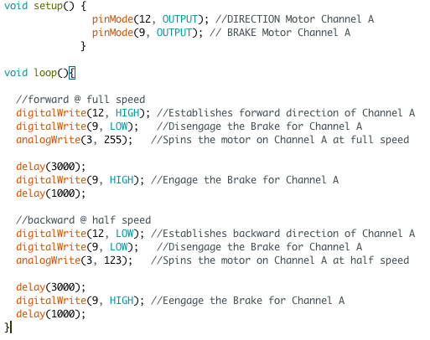
Example 3: Motor shield driver for Arduino board based on L298P Dual H-bridge
motor voltage
Easy implementation
ChanelΑ
Β Chanel
Pin 12 = Direction
Pin 9 = Break
Pin 3 = Speed
Pin A0 = current sensing

Slide 15
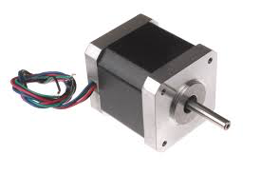
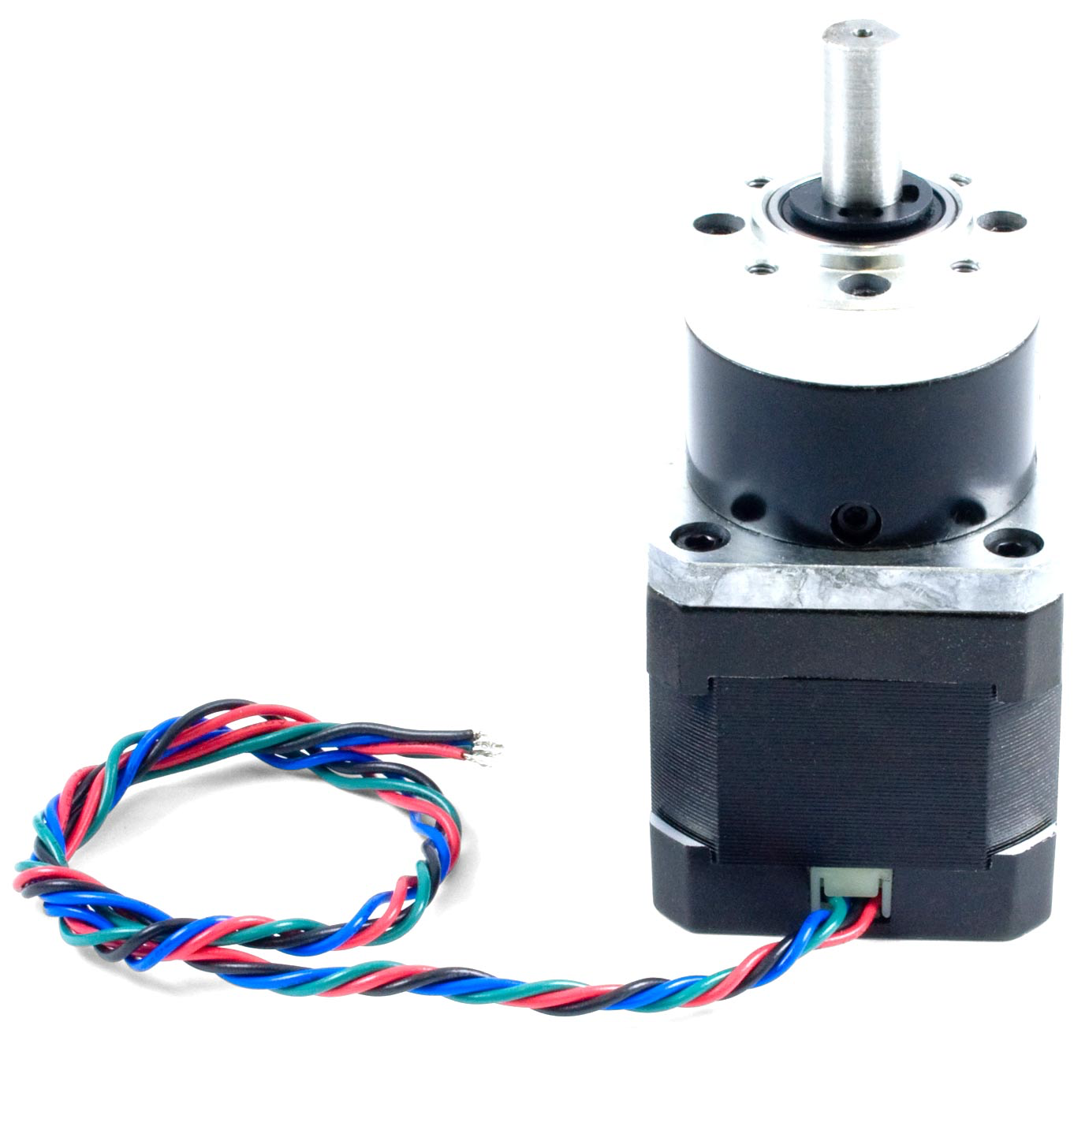
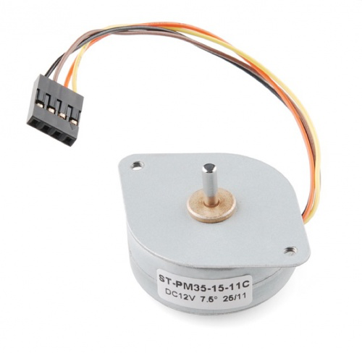
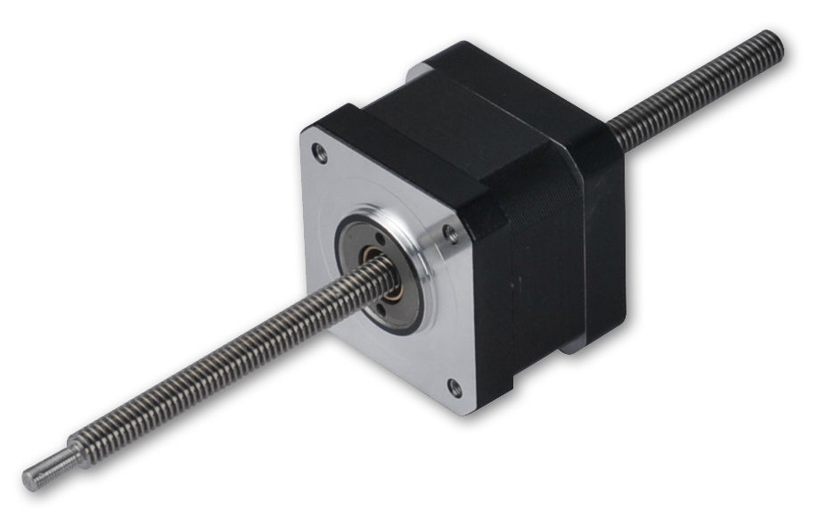
Stepper motor
Stepper motor

Slide 16
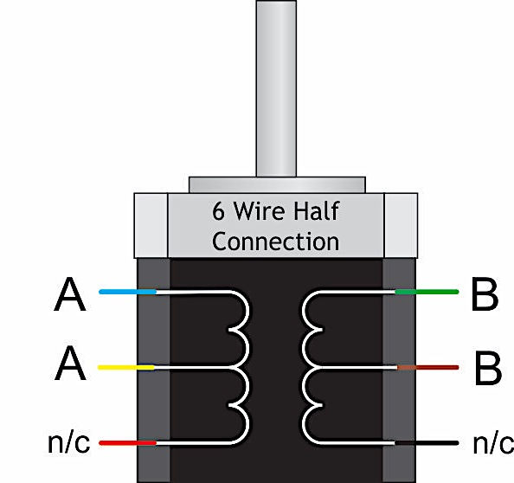
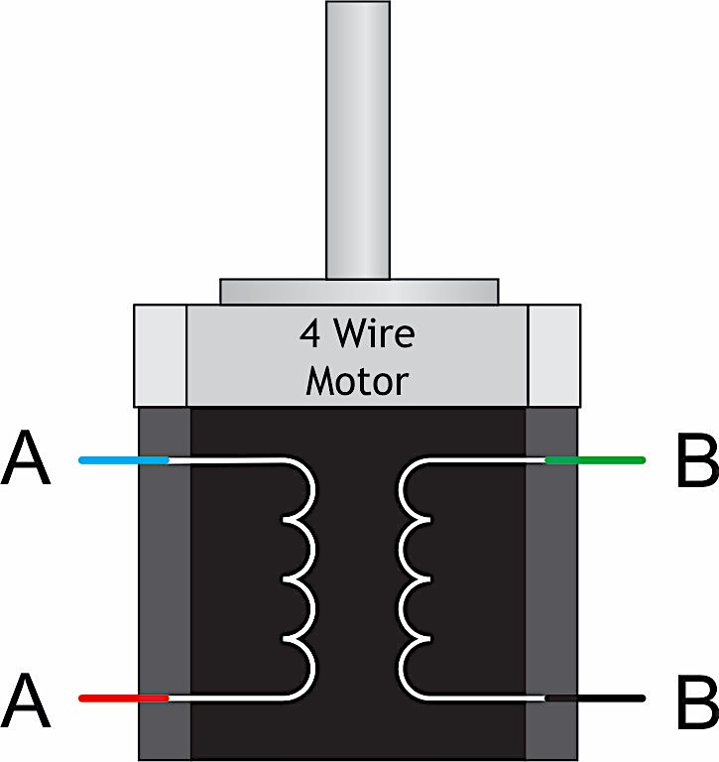
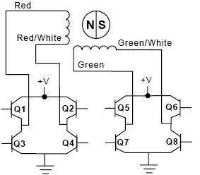
Driving circuits for Unipolar and Bipolar Stepper motors
Unipolar Stepper motor
Basic moving principle
Bipolar Stepper motor
Bipolar step | Q2-3 | Q1-4 | Q6-7 | Q5-8
Unipolar step | Q1 | Q2 | Q3 | Q4
1 | ON | OFF | ON | OFF
2 | OFF | ON | ON | OFF
3 | OFF | ON | OFF | ON
4 | ON | OFF | OFF | ON
1 | ON | OFF | ON | OFF
Unipolar stepper motor driver
Bipolar/Unipolar stepper motor driver
Create stepper objects to control a stepper motor
Functions that are utilized by the Stepper library (stepper library for Arduino) #include <Stepper.h>
Stepper my_Stepper_1( value1_define_steps_per_revolution, pin1, pin2 ) Two wire control
my_Stepper_1(value1_define_steps_per_revolution, pin1, pin2, pin3, pin4 ) Four wire control
my_Stepper_1.setSpeed(value2_define_max_speed_during_motion) Set max speed during the motion of the motor
my_Stepper_1.step(value3_define_desired steps) Move the rotor for the number of desired steps

Slide 17
Bipolar/Unipolar stepper motor driver with the IC L293D (four wires control)
Four wires control of a stepper motor
Bipolar stepper motor
Unipolar stepper motor
Exactly the same circuit, the common wires are connected to the motor voltage power supply.
Vcc
motor
Vcc motor
5 volts
1 ή 0
GND
1 ή 0
Vcc motor
GND
Vcc motor
1,2EN and 3,4EN are set to 5 volts
A stepper motor follows the turns of a potentiometer on analog input A0.

Slide 18
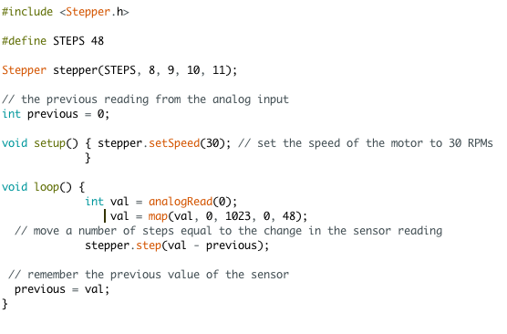
Example 4: Follow the turns of a potentiometer (unipolar/bipolar stepper motor)
A stepper motor follows the turns of a potentiometer on analog pin A0
Four wires control of a stepper motor

Slide 19
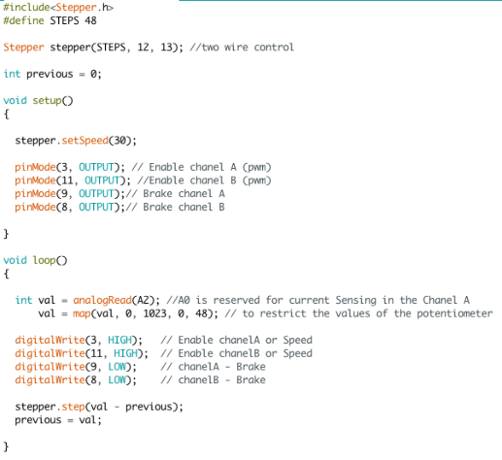
Example 5: Bipolar/Unipolar stepper motor driver with the motor shield (two wire control)
Bipolar/Unipolar stepper coils
ChanelΑ
Β Chanel
Two wires control of a stepper motor
A stepper motor follows the turns of a potentiometer
The analog pin is changed to A2

Slide 20
Thank You

